Slide 1
Advanced Tax Strategies
Understanding the Tax Landscape Beyond Your Paycheck.
Notes:
This presentation is the final part of a four-part series on taxes. For the best learning experience, we recommend completing the first three lessons before this one.

Slide 2
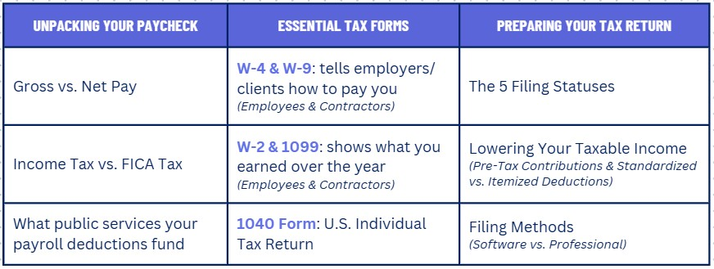
What We’ve Covered
Notes:
Before we jump into our final topic on taxes, let's take a moment to review what we already learned:
First, in 'Unpacking Your Paycheck,’ we learned the difference between Gross and Net pay, we distinguished between Income and FICA taxes, and we tracked where that money goes to fund public programs.
Next, in 'Essential Tax Forms,' we covered the entire lifecycle of your tax documents—from the W-4 when you're hired, to the W-2 and 1099 summaries you receive at year-end, all the way to the final Form 1040 you file with the IRS.
And finally, in 'Preparing Your First Tax Return,' we learned how to put it all into practice. We covered choosing your Filing Status, choosing your type of Deductions, and how to choose between Traditional and Roth retirement accounts.

Slide 3






What We’ll Cover: Advanced Tax Strategies
Taxes on Investments (Capital Gains)
Understanding how your profits from selling assets like stocks are taxed.
Taxes on Wealth Transfer
Taxes on Property
The rules for passing assets to the next generation through estates, inheritances, and gifts.
How the annual tax on real estate works and what it funds in your community.
Notes:
In our previous lessons, we mastered the taxes on earning money. Today, we're focusing on the taxes you'll encounter as you build and manage your wealth. We'll cover three key areas:
First, Taxes on Investments, which is the tax you pay on profits from selling assets like stocks.
Next, Taxes on Wealth Transfer, which covers the rules for passing assets to the next generation.
And finally, Taxes on Property, the annual tax that funds local communities.
By the end, you'll have a complete picture of the major taxes you'll navigate throughout your financial life.

Slide 4


Taxes on Investments: Capital Gains
A tax on the profit you make from selling an asset for more than you paid for it. This applies to stocks, real estate, and other investments.
If you hold the asset for < 1 year. The profit is taxed at your regular marginal income tax rate.
If you hold the asset for more than one year. The profit is taxed at lower, preferential rates.
The government wants to encourage long-term investing for retirement and economic stability.
Notes:
A Capital Gain is the profit you make when you sell an investment—like a stock or a piece of real estate—for more than you originally paid for it. That profit is considered taxable income.
The amount of tax you pay comes down to: Did you own the asset for more than one year?
If the answer is no—you held it for a year or less—it's a Short-Term Capital Gain. The government treats this like regular income, and the profit is taxed at your highest marginal tax rate. Think of this as the tax on ‘active traders'.
If the answer is yes—you held it for more than one year—it becomes a Long-Term Capital Gain. This is where you get a tax advantage. The profit is taxed at a much lower, preferential rate. This is your reward for being a patient 'long-term investor’.
As the slide says, the government wants to encourage stable, long-term investing for things like retirement, which is good for the entire economy.

Slide 5



How to Calculate Capital Gains Tax
In Year 5 of your career, you sell some of your shares. You bought 10 shares of a company for $1,000. You sell them three years later for $3,000.
Determine the profit from your investment.
Most people fall into the 15% long-term capital gains tax bracket
$3,000 (Sale Price) - $1,000 (Cost Basis) = $2,000 (Long-Term Capital Gain)
$2,000 (Gain) X 0.15(Tax Rate) = $300
Your tax on this $2,000 investment would be $300. This is much lower than if it were taxed as regular income.
Notes:
Now let's walk through a simple, real-world example to see how it works in practice.
You bought 10 shares of a company for a total of $1,000. Three years later you sell those same shares for $3,000.
Step 1 is to Calculate the Gain.
This is just simple subtraction. The profit is the difference between what you sold it for and what you paid. The official term for what you paid is the 'Cost Basis’.
So, we take the $3,000 Sale Price, subtract the $1,000 Cost Basis, and that gives us a profit, or gain, of $2,000. And because you held the shares for three years—which is more than one year—we know this is a Long-Term Capital Gain.
Step 2 is to Apply the Tax Rate.
Since this is a long-term gain, we get to use the lower, preferential tax rates. While these rates can vary, the most common bracket for most people is 15%.
So, we take our $2,000 gain and multiply it by the 15% tax rate, which gives us a total tax of $300.
Your tax on a $2,000 investment profit is only $300.
If this had been a short-term gain, that same $2,000 profit would have been taxed at your regular income tax rate—which could be 22%, 24%, or even higher. The tax would have been significantly more.

Slide 6
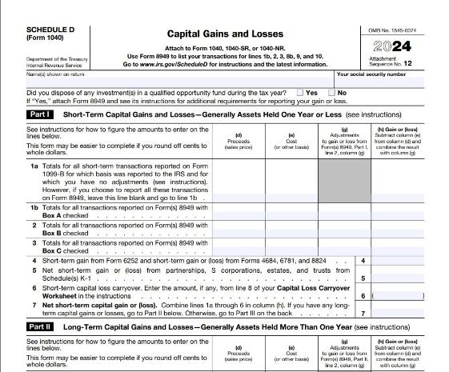
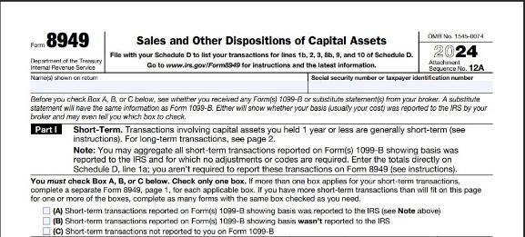
How Capital Gains Are Reported
Capital gains and losses are first calculated on Form 8949.
The totals from Form 8949 are then summarized on Schedule D, which is attached to your main Form 1040.
Notes:
So, we've calculated our $2,000 long-term capital gain. Now, where does that number go on your tax return?
Step 1 is Form 8949.
This is where you list out every single investment you sold during the year—the purchase date, sale date, cost, and sale price.
The good news is, your brokerage firm will send you a tax form called a 1099-B that has all this information neatly organized for you. You'll use that to fill this out.
Step 2 is Schedule D.
After you've listed all your transactions on Form 8949, you then take the totals and move them to Schedule D.
Schedule D is the summary page. It boils everything down to just two key numbers: your total short-term gain or loss, and your total long-term gain or loss.
Finally, that net gain or loss from Schedule D gets carried over to your main Form 1040, where it joins the rest of your income.
If you use tax software, it will do all of this for you. But this is what's happening behind the scenes.

Slide 7



Taxes on Wealth Transfer
These are taxes designed to manage the transfer of assets (like property, investments, and cash) from one person or generation to the next.
Notes:
This brings us to the topic of Wealth Transfer Taxes. These are the rules that govern how assets—like property, investments, and cash—are passed from one person to the next, either during life or after.
The Estate Tax: which is a federal tax on a person's assets after they pass away.
The Inheritance Tax: a less common tax levied by a handful of states.
The Gift Tax: a federal tax on large gifts given during a person's lifetime.

Slide 8


Estate Tax vs. Inheritance Tax
Estate Tax
Inheritance Tax
What it is: A tax on the assets that an individual receives from someone who has passed away.
Who Pays: The heir (the person receiving the money) pays the tax.
A state-level tax only; there is no federal inheritance tax.
States with inheritance tax: Iowa, Kentucky, Maryland, Nebraska, New Jersey, and Pennsylvania.
What it is: A tax on the total value of a person's assets, (property, cash, investments) that they leave behind when they die.
Who Pays: The estate of the deceased person pays the tax before heirs receive their money.
Notes:
Now let's break down two terms that are often confused: Estate Tax and Inheritance Tax. They both deal with transferring wealth after someone passes away, but they are very different.
On the left, you have the Estate Tax.
This is a federal tax.
Think of it as a tax on the total value of the deceased person's estate—all their property, cash, and investments combined.
The tax is paid by the estate itself, before any money is handed out to the heirs. It’s like the government takes its slice from the whole pie first.
On the right, you have the Inheritance Tax.
Instead of taxing the entire estate, it taxes what each individual heir receives.
This is a state-level tax only. There is no federal inheritance tax.
This means the bill goes to the person receiving the money, not the estate.
As of 2024, only six states have one. Even in those states, the tax you pay often depends on your relationship to the person who passed away. A surviving spouse almost never pays inheritance tax. A child might pay a very low rate, while a distant cousin or a friend would pay a much higher rate. The closer the relative, the lower the tax.
Reference: https://taxfoundation.org/data/all/state/estate-inheritance-taxes/

Slide 9
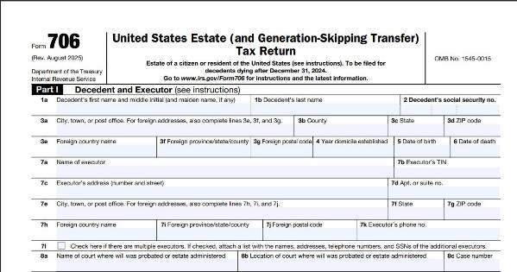
Filing the Estate Tax Return (Form 706)
The Filing Requirement: A return (Form 706) is only required if the total estate's value exceeds the high federal exemption limit (e.g., over $13 million per individual in 2024).
Step 1: Calculate the Gross Estate
Step 2: Determine the Taxable Estate
Step 3: Compute the Tax
Notes:
Step 1: Calculate the Gross Estate
The executor must catalog all of the deceased's assets (property, investments, cash, etc.) at their current Fair Market Value.
Step 2: Determine the Taxable Estate
From the Gross Estate, subtract all eligible deductions. Common deductions include debts, mortgages, administrative expenses, and assets passing to a surviving spouse or charity.
Step 3: Compute the Tax
The final tax is calculated on this net amount and then reduced by the available Unified Credit (the official term for the lifetime exemption).
Strategy for Couples
An estate can elect to transfer any unused exemption to a surviving spouse, effectively doubling the amount a married couple can pass on tax-free. This election is made on Form 706.

Slide 10

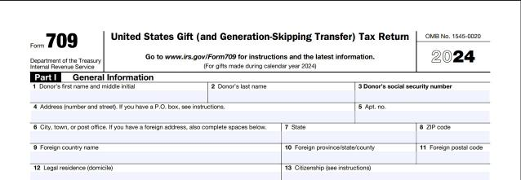
Gift Tax
Gift Tax Return (Form 709)
What it is: A tax on large gifts of money or property you give to someone while you are still alive.
Purpose: To prevent people from avoiding the estate tax by giving away all their wealth before they die.
The person who gives the gift is the one responsible for filing Form 709.
The Annual Exclusion Rule: You can give up to a specific, inflation-adjusted amount to any number of individuals each year without any tax consequences or paperwork.
Notes:
Our final wealth transfer topic is the Gift Tax. This is the federal tax that works hand-in-hand with the estate tax.
It’s a tax on large gifts of money or property you give to someone while you are still alive.
Its main purpose is to prevent a loophole. Without it, someone could simply give away all their money to their heirs right before they pass away to avoid the estate tax. The gift tax closes that loophole.
The government allows you to give up to a certain amount to any number of people every single year, completely tax-free. You don't even have to report it.
This amount is adjusted for inflation, (e.g., $18,000 per person in 2024). This means you could give $18,000 to your child, $18,000 to your grandchild, and $18,000 to a friend, all in the same year, with no tax consequences. Normal birthday and holiday gifts are completely safe.
So, When Do You File Form 709?
You only need to file if a gift you give to a single person is NOT one of those special exceptions (like tuition) AND it's **more than** the annual exclusion amount for that year.
* Even if you file, you typically **don't pay any tax**. Filing simply subtracts the excess amount from your multi-million dollar lifetime estate and gift tax exemption.
* And one final, crucial point: the responsibility to file Form 709 is always on the person who **gives** the gift, not the person who receives it."

Slide 11


Gift Tax Exemptions
The following are not considered taxable gifts at all, regardless of of their amount:
Tuition or medical expenses
Gifts to your spouse
Gifts to qualifying charities
Notes:
The following are not considered taxable gifts at all, regardless of the amount:
Tuition or medical expenses you pay directly to the school or hospital on someone else's behalf.
Gifts to your spouse.
Gifts to qualifying charities

Slide 12
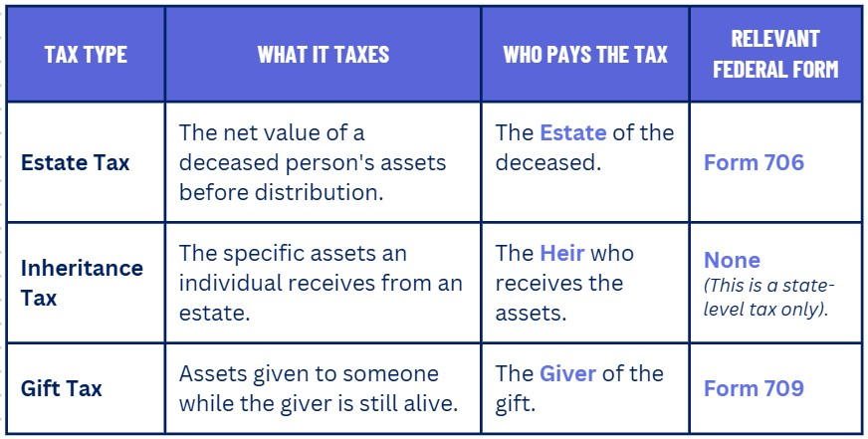
Summary of Wealth Transfer Taxes
Notes:
This table summarize the key differences so you can keep them straight. Let's walk through it:
First, we have the Estate Tax.
Remember, this is the federal tax on the entire pie—the total net value of a person's assets after they pass away.
The Estate itself pays the tax before any money is distributed to the heirs.
This is reported on Form 706.
Next is the Inheritance Tax.
This is a tax on the individual slice of the pie that someone receives.
The responsibility for paying the tax falls on the Heir.
This is a state-level tax only, which is why there's no federal form.
Finally, we have the Gift Tax.
This is the tax that applies while you're still alive, on large gifts you give to others. Its main purpose is to prevent people from avoiding the estate tax.
The key difference here is that the person who Gives the gift is the one responsible for filing the tax form, Form 709.
So, a simple way to remember who pays is:
The Estate pays the Estate Tax.
The Inheritor (or heir) pays the Inheritance Tax.
And the Giver pays the Gift Tax.

Slide 13


Property Taxes
What it is: An annual tax levied by local governments on the value of real estate (land and buildings).
What it Funds: Primary funding source for most local services:
Public Schools
Police & Fire Departments
Libraries, Parks and Local Roads
How It’s Calculated: Based on the assessed value of your property multiplied by the local tax rate (often called a "millage rate").
There is no federal form. Your local county or city tax office will send you a bill directly each year.
Notes:
This tax is different from the others we've discussed because it's not about your income or investments; it's about the value of the place you live. It's an annual tax that your local government—your city or county—charges on the value of your real estate.
Where does the money go?
The money from property taxes stays in your community. It is the primary funding source for essential local services that we all use every day, like our public schools, our police and fire departments, and our local libraries and parks.
How is it calculated?
Your local government determines an 'assessed value' for your home, and then they multiply that by the local 'tax rate,' sometimes called a 'millage rate.’
Unlike the other taxes, there's no federal form to fill out. Your local tax office simply sends you a bill directly each year.
Homeowners can often lower their property tax bill by applying for exemptions.
The most common one is the Homestead Exemption, which reduces the assessed value of your home if it's your primary residence. Many areas also offer exemptions for seniors, veterans, or for making certain home improvements.

Slide 14
Staying Up-to-Date
Tax laws are always changing.
The most reliable source for the current rates is the official IRS website.
Search for 'IRS Estate and Gift Tax' or 'IRS Capital Gains Tax Rates' for the current year.
Notes:
Throughout this presentation, we've mentioned specific dollar amounts—the gift tax exclusion, the estate tax exemption, and capital gains tax rates. Remember that tax laws are not static. They are updated almost every year, sometimes to adjust for inflation, and sometimes because Congress passes new legislation. The goal isn't to memorize today's numbers; it's to know how to find tomorrow's numbers.
The most reliable source is the official IRS website: https://www.irs.gov/
An online search for the terms like 'IRS Estate and Gift Tax' or 'IRS Capital Gains Tax Rates' for the current year—will almost always take you directly to the official government page with the correct, up-to-date information.

