Slide 1
Many schools have Biology Labs, but does yours have a Personal Finance Lab?
The NEW Way to Teach
Business, Personal Finance, & Economics

Slide 2
What We Will Cover
Introduction & Background to our Company (Stock-Trak Inc.) and website (PersonalFinanceLab.com)
The “Lab” Concept
Current Status of Financial Literacy Education (Personal Finance, Economics, Business curriculum)
Trends and Best Practices
What is a Personal Finance Lab
What Subjects can be Taught in a Lab
How to Build a Lab and Approximate Costs

Slide 3
Kevin Smith, Research and Operations Specialist
The Leader in Stock Market Trading Simulations For High Schools, Middle Schools, and Universities Since 1990
Family of Sites Were Used by over 750,000 students last year
19,600 contests created by 14,200 teachers last year
Over 8,000,000 students have used one of our various sites since 1990

Slide 4
“…60 per cent of those in secondary school were neglected. The college preparatory curriculum was too remotely related to the lives they were living and were going to live; students didn’t plan to become skilled in any particular trade because the jobs open to them did not demand the kind of training schools could offer”
Carl Franzen, 1951
Notes:
Before I get into “Labs”, I want to start with a bit of a “status update” with personal finance education. There is a problem of engagement in high schools – particularly in teaching personal finance, economics, and business topics. Just about everyone agrees that these “should” be part of the curriculum, but very few schools need to start.
This isn’t a new problem – it was the central focus all the way back into the 40’s. Educators and parents were both frustrated by the school system putting students either on the “college track”, (a lot of classwork focusing on abstract math, literature, and history) or “trades” track (focusing on preparing students to enter a trade). The criticism was that these tracks were not engaging for the average student, and did not prepare them for live after graduating high school – personal budgeting, insurance, taxation, how to get a job, how to conduct themselves at work, and generally transitioning from adolescence into adulthood.

Slide 5
Life Adjustment Education
How to “Live” – personal finance, budgeting, civics, how to find a job and behave at work
Concept developed between 1947 and 1956
Heavily promoted by parents that grew up during the Great Depression
Notes:
This created a new paradigm in schools – the “Life Adjustment Education”. This was a big deal – the concept was developed and started to be implemented in a piecemeal fashion between 1947 and 1956. It was extremely popular with parents who grew up during the great depression because of the focus on “life skills”.
However, in 1957, this was abruptly stopped, and the national education focus immediately switched gears, and most of the work was abandoned. The reason: Sputnik

Slide 6
Immediate and Radical Transformation
Immediate national “Crisis” – shortage of STEM graduates
Money poured in – science labs and curriculum appeared in every school
Notes:
The launch of Sputnik caused a panic in the US education system, and the national priorities immediately shifted to producing more STEM graduates to compete with the Russian’s supposed “edge”. National money poured in – while some high schools had lab spaces before, this is when they became a feature of every school

Slide 7
Curriculum Centrally Developed
Biology
Chemistry
Mathematics
Physics
Notes:
The original standardized “Lab” was part of a curriculum package promoted by the National Science Foundation, which included fairly radical overhauls of several core subjects – Biology, Physics, Chemistry, and Math. They centrally developed curriculum guidelines and textbooks, which then were filtered down to teachers.
Now, when we think about education reform in the 60’s, we can see a couple clear winners and losers

Slide 8
NSF STEM Curriculum Results
Hard Sciences
New Math
“Teacher-Proof” Curriculum
Experiential Learning
Lab-Based
Teacher Training & Consistent Standards
Direct Instruction Only
Unqualified Teachers
Inadequate Teacher Training
Unhappy Parents
Notes:
The hard sciences did fairly well. The NSF produced “Teacher-proofed” lessons to launch the program – both by having lots of video reels produced and distributed but also by having an extremely strong focus on experiential learning in a Lab. This was followed up with teacher training programs and a wider range of curriculum developed through the 60’s and 70’s – once there were enough qualified teachers to drop some of the film reels.
This contrasts to “New Math”, which is pretty much the poster child for failure in education reform. New math came from the same conceptual framework as the developments in the hard sciences, but with some key differences:
There was no “Lab”, - still bored high school students in a classroom
There was no “Teacher Proofing” – the curriculum didn’t include the same kinds of pre-packaged lessons that teachers could “set and forget”, and it was not followed up with appropriate teacher training to get them up to speed.
And there were unhappy parents. When a parent visited their kid’s school, they can see the chemistry lab, they can see the biology lab and understand immediately what their students were learning – even if the parents didn’t know that material themselves. This did not carry over into math – as far as parents were concerned, schools just made everything harder for no reason.
Math had plenty more reforms afterward, but the real winners were the lab-based, experientally-focused “hard sciences”.

Slide 9
Why Labs Work
The Doorway Effect
Walking through a doorway into a significantly different space triggers certain psychological mechanisms
Coolest classroom at the school boosts enrollment

Slide 10
Fast Forward To Today…
Notes:
Fast forward to today – we have a new crisis. The original reasons for pushing for “life adjustment education” never went away, and the financial stability of young people is getting worse. As a country, we’ve begun to recognize this, and more time, money, and effort is being spent to fix it. More and more states are mandating economic and personal finance education, CTE programs are growing and expanding their business programs because those are the skills that are widely transferrable between jobs and whole industries.

Slide 11
The “Coach” Problem
State passes requirement that Personal Finance or Economics be taught in schools
…But no (or very little) funding is allocated to support it
Schools do not have resources to hire new teacher (and very few may even exist), so “Coach” gets an extra class to teach – with whatever resources they can find
Notes:
The “Coach” problem. Like I said at the beginning, we’ve been at this for 30 years, and work with tens of thousands of teachers each year. And we see a similar trend every time a new school district starts mandating “Personal Finance” or “Economics” be taught as a class – they take a teacher from somewhere else and add it to their plate. If we look at first-time teacher usernames, the most common theme is “Coach” – teachers reshuffle staff away from PE and extracurriculars to cover the new subject requirement.

Slide 12
Why this is so Hard: Many Different Standards
Personal Finance / Financial Literacy: Jumpstart Coalition
Other standards published by NBEA and Council on Economic Education
Economics: Council for Economic Education
Other standards published by NBEA
Business: National Business Education Association
Accounting
Management
Marketing
Also Standards Published by Advance CTE
…Plus dozens of state standards!
Notes:
BUT there is no standardization on how this is handled. Every subject in the “Financial Literacy” umbrella has multiple sets of standards published by organizations fighting the same donation dollars. When states adopt standards themselves, they also make tons of changes – I’ve never seen two states that have the same sets of standards for what should be included in a “personal finance” or even “Accounting” class.
There are basically 4 big players on the national stage, and I make it my business to keep tabs on their recommendations.
For Personal Finance, the biggest name is the Jumpstart Coalition, which has been working since the 90’s to develop and propagate standards for Personal Finance at the national level. Most states that follow National standards are working off the Jumpstart recommendations.
For Economics, the Council for Economic Education is the big player, and have been for over 70 years. They made big pushes since the 90’s to make Economics a required class in high schools, and did a lot of good work getting most states more or less on the same page
Business is a bit muddier. I tend to focus on the National Business Education Association, which publishes a comprehensive set of standards just focused on the business topics. Advance CTE also publishes their own standards – I don’t refer to them quite as often because their scope is so much bigger (covering basically all CTE), but there is a lot of overlap between the two.
The big problem here is in the small notes – all three of these big players are focused on improving FinLit, but they really don’t seem to like each other.
Jumpstart has been publishing their pfin standards since the 90s, and have a huge level of penetration in the states. I have no idea why the Council for Economic Education started publishing another competing set of standards in 2013, because it is out of their wheelhouse and just makes the mission of both organizations more difficult.
NBEA has a lot of penetration with business teachers, but as far as I can tell, they don’t talk to either of the big players. For some reason, they decided to also publish their own set of National Standards for both Personal Finance and Economics – again jumping out of their comfort zone to step on the toes of the other big players.
So this really presents a pretty clear picture of both a pretty serious problem, but also gives individual districts and states a really powerful hint on the best way to approach teaching all 6 subjects. The Economic promoters and Business promoters both feel comfortable sticking their fingers in the Personal Finance pie because the way these subjects need to be approached by the teachers is all heavily interrelated.

Slide 13
State Level Variations in Requirements…
California
Texas
Utah
PFin – No State Standards
Econ – Required Class
Financial Literacy School Rank: F
PFin – Required Standards + Testing
Econ – Required Class + Testing
Financial Literacy School Rank: B
PFin – Required Class + Testing
Econ – Required Class + Testing
Financial Literacy School Rank: A
Notes:
First, I want to look at the National level of what the biggest names in financial literacy are suggesting, and how these play off each other. There are basically 4 big players on the national stage, and I make it my business to keep tabs on their recommendations.
For Personal Finance, the biggest name is the Jumpstart Coalition, which has been working since the 90’s to develop and propagate standards for Personal Finance at the national level. Most states that follow National standards are working off the Jumpstart recommendations.
For Economics, the Council for Economic Education is the big player, and have been for over 70 years. They made big pushes since the 90’s to make Economics a required class in high schools, and did a lot of good work getting most states more or less on the same page
Business is a bit muddier. I tend to focus on the National Business Education Association, which publishes a comprehensive set of standards just focused on the business topics. Advance CTE also publishes their own standards – I don’t refer to them quite as often because their scope is so much bigger (covering basically all CTE), but there is a lot of overlap between the two.
The big problem here is in the small notes – all three of these big players are focused on improving FinLit, but they really don’t seem to like each other.
Jumpstart has been publishing their pfin standards since the 90s, and have a huge level of penetration in the states. I have no idea why the Council for Economic Education started publishing another competing set of standards in 2013, because it is out of their wheelhouse and just makes the mission of both organizations more difficult.
NBEA has a lot of penetration with business teachers, but as far as I can tell, they don’t talk to either of the big players. For some reason, they decided to also publish their own set of National Standards for both Personal Finance and Economics – again jumping out of their comfort zone to step on the toes of the other big players.
So this really presents a pretty clear picture of both a pretty serious problem, but also gives individual districts and states a really powerful hint on the best way to approach teaching all 6 subjects. The Economic promoters and Business promoters both feel comfortable sticking their fingers in the Personal Finance pie because the way these subjects need to be approached by the teachers is all heavily interrelated.

Slide 14
Learning From History
Business and Personal Finance teachers are realizing that…

Slide 15
Many High Schools have Chemistry Labs…

Slide 16
… Many High Schools have Biology
Labs…

Slide 17
… Many High Schools have
Auto
Shops…

Slide 18
…Many High Schools have Culinary Art Labs…

Slide 19
…And Now High Schools are Adding Personal Finance Labs!

Slide 20
Turning
This…

Slide 21
and
This…

Slide 22
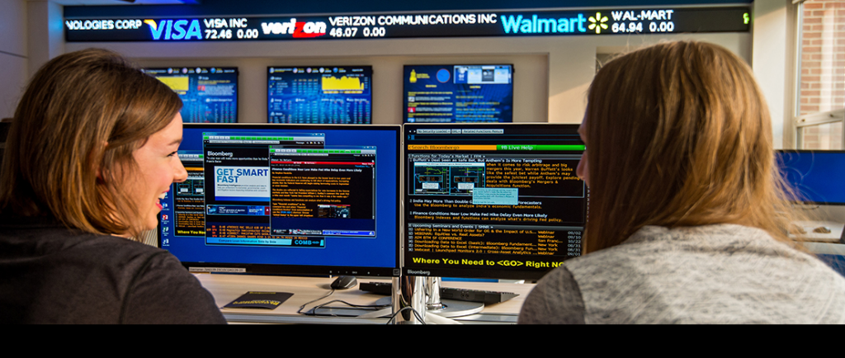
…Into
This!

Slide 23
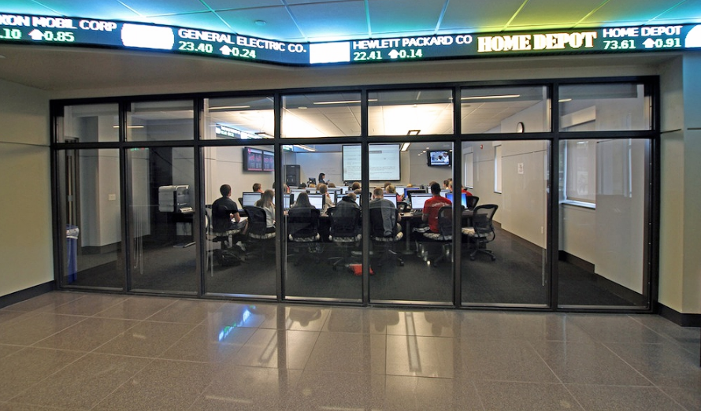
…And
This...

Slide 24
…And
This...

Slide 25
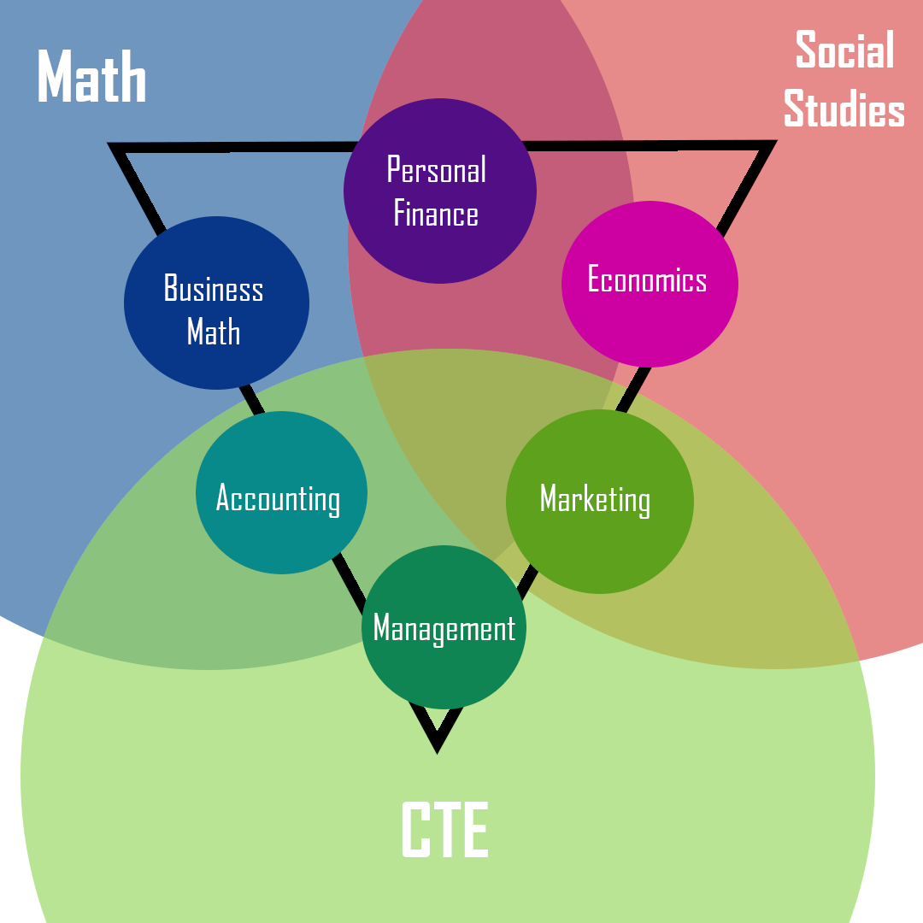
Notes:
This is where that experiential component and “lab” come back into play – the best ways to approach these topics NEEDS to be flexible because there isn’t even consistency in “who is teaching this class” – every state and every district has some variation

Slide 26
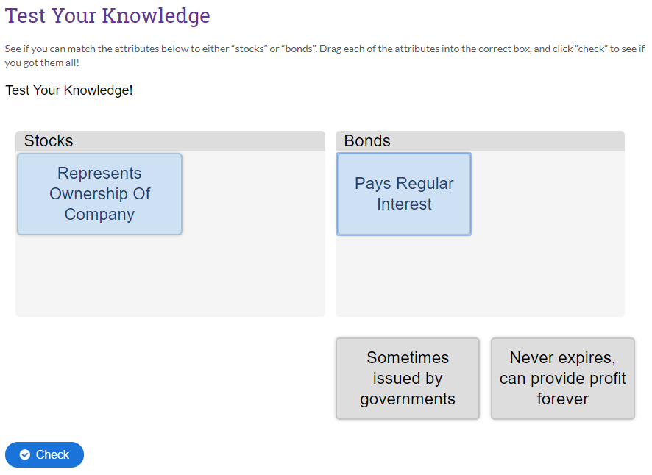
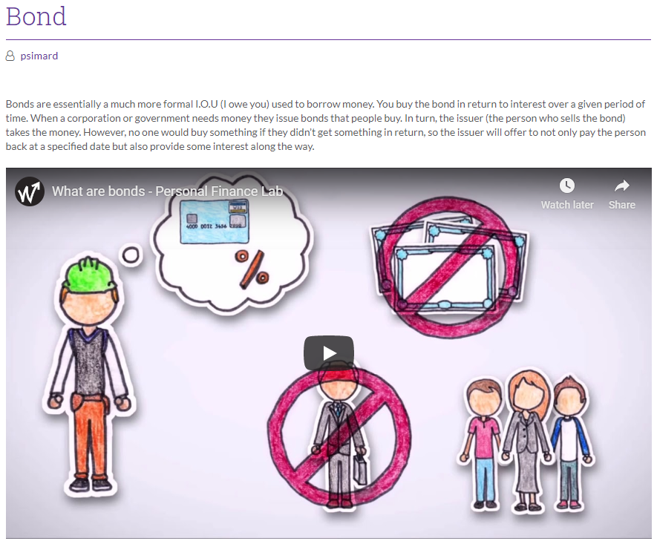
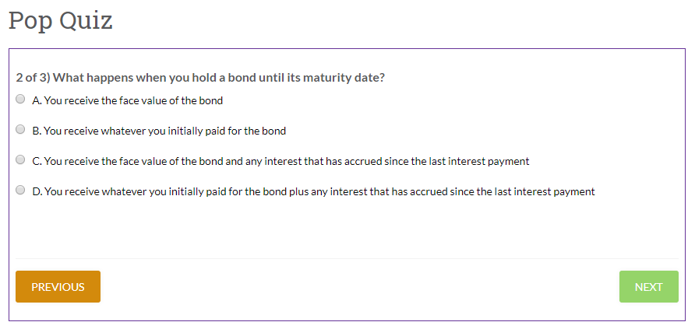
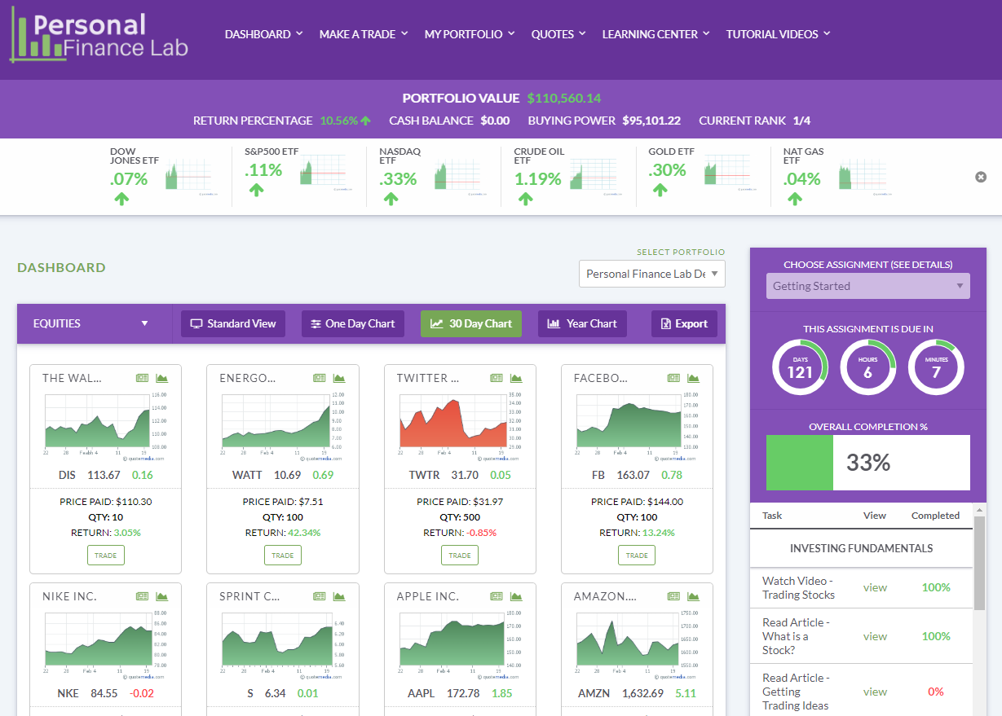
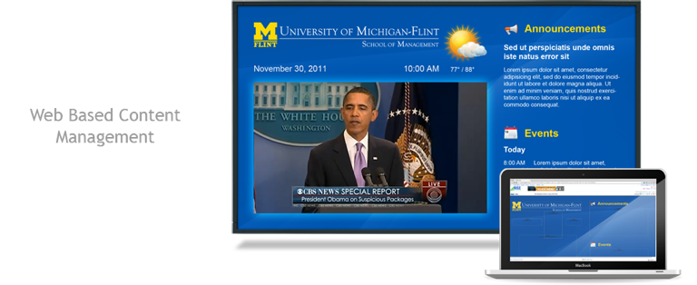
Essential Lab Components
Flexible Curriculum
Experiential Games
Hardware

Slide 27
Introducing PersonalFinanceLab.com
Combines a customizable Stock Game and Budgeting Game with embedded curriculum for:
Business
Personal Finance
Economics
Social Studies, and
Math

Slide 28
PersonalFinanceLab.com Features
Built-In Lessons
Integrated videos, articles, and calculators
Wide library available – 300 lessons crossing all 6 subjects
Teachers can mix and match – pick topics for this week, plus supplements from other subjects that help drive lessons home
Notes:
This is the real game-changer, and one of the most important drivers in making stock games an important cornerstone between subjects.
With our games, teachers can add what we call “Assignments” to their class. This involves watching videos, reading articles, using interactive calculators, and other activities, all built right into the stock game. There are over 300 activities available, and each one is aligned to different standards across all 6 subjects.
For the teacher, we organize them by subject to make it easy to find the topics that match what you cover in class each week. This doesn’t mean you are limited – Personal Finance teachers can include Accounting topics, Management teachers can include Economics lessons, and all points in between.
This is a truly powerful way to reinforce the learning between classes. It is 100% web-based, so teachers can have students work on these activities in class, or have them just as homework assignments. Since teachers have the whole gamut available, it lets them grab related topics from other subjects and add them as supplements to their own classes, with just one click.
It stays extremely interactive with students too – they get a progress bar and prompt every time they log in showing the activities their teacher wants them to do each week. Teachers can even make more than one assignment at a time, so there can be some “Required” activities for this week, plus some “Optional” supplements.
All the tutorials on how to actually manage a portfolio are also built in as a “Getting Started” recommended assignment. This means teachers can literally take two minutes to set their class rules, one more minute to enable the “Getting Started” pack of activities, and set their students loose as a homework assignment – no class time required.

Slide 29
PersonalFinanceLab.com Features
Built-In Assessments
Self-grading pop quizzes, saving student’s scores with real-time progress reports
Teacher Reports
Full activity logs for each student, one-glance class status, and automated grade books
Notes:
This is the important part – remember those 300 activities I said were aligned to standards? We take it a step farther – each one ends with a built-in assessment. This is usually a pop quiz between 3 and 5 questions, and the teacher can choose whether students can retry the quizzes for a higher score, or if it saves their first try to a grade book.
All student activities in the platform are logged and trackable. You can see what stocks were the most popular last week, and use that as a jumping off point for class discussions. If you want to give class participation bonuses, you can award students extra cash in their accounts.
And of course this is all real-time. All the stock prices, all the ranking values, and all points in between are using live market data to keep students fully engrossed both in the class itself, and the world around them.

Slide 30
PersonalFinanceLab.com Features
Budgeting Game
Students take the role of college student with a part-time job
Randomized events entice impactful decisions
Objectives are to build up credit score, transfer money to savings account, and maintain work/life/study balance
Notes:
Stock games are not in a vacuum. The reason we keep up with all these trends is because we’re excited to see how our tools are used, why they work, and encourage more schools to get involved.
What we have been working on is taking all of these best practices and lessons learned, and building it directly into the stock game, so teachers can skip all the heavy lifting.
The first way we do this is putting the note-taking directly into the trading flow. Teachers can require students to take notes with every trade explaining their rationale, and relate these decisions back to classroom topics. Students and teachers can both see their trading diaries, which is an excellent way to get started on end-of-semester reports relating each decision back to class.
Students can never edit their notes, but they can add more later to old trades

Slide 31
PersonalFinanceLab.com Features
Stock Market Game
Used by 15,000+ classes each year
Extremely easy to use, with built-in tutorials
Integrated research, class rankings, and exportable reports
Notes:
This is the real game-changer, and one of the most important drivers in making stock games an important cornerstone between subjects.
With our games, teachers can add what we call “Assignments” to their class. This involves watching videos, reading articles, using interactive calculators, and other activities, all built right into the stock game. There are over 300 activities available, and each one is aligned to different standards across all 6 subjects.
For the teacher, we organize them by subject to make it easy to find the topics that match what you cover in class each week. This doesn’t mean you are limited – Personal Finance teachers can include Accounting topics, Management teachers can include Economics lessons, and all points in between.
This is a truly powerful way to reinforce the learning between classes. It is 100% web-based, so teachers can have students work on these activities in class, or have them just as homework assignments. Since teachers have the whole gamut available, it lets them grab related topics from other subjects and add them as supplements to their own classes, with just one click.
It stays extremely interactive with students too – they get a progress bar and prompt every time they log in showing the activities their teacher wants them to do each week. Teachers can even make more than one assignment at a time, so there can be some “Required” activities for this week, plus some “Optional” supplements.
All the tutorials on how to actually manage a portfolio are also built in as a “Getting Started” recommended assignment. This means teachers can literally take two minutes to set their class rules, one more minute to enable the “Getting Started” pack of activities, and set their students loose as a homework assignment – no class time required.

Slide 32
PersonalFinanceLab.com Features
Built-In Note Taking
Ask students directly when making trades to explain why this, but not that
This makes the relation back to class topics automatic
Students can’t edit their notes, but they can see them and add new ones
Notes:
Stock games are not in a vacuum. The reason we keep up with all these trends is because we’re excited to see how our tools are used, why they work, and encourage more schools to get involved.
What we have been working on is taking all of these best practices and lessons learned, and building it directly into the stock game, so teachers can skip all the heavy lifting.
The first way we do this is putting the note-taking directly into the trading flow. Teachers can require students to take notes with every trade explaining their rationale, and relate these decisions back to classroom topics. Students and teachers can both see their trading diaries, which is an excellent way to get started on end-of-semester reports relating each decision back to class.
Students can never edit their notes, but they can add more later to old trades

Slide 33
PersonalFinanceLab.com Features
I’m going to the store to buy some food
Lesson Plan: Buy What You Know!
Show your students how to THINK about their spending habits!
Notes:
This is the important part – remember those 300 activities I said were aligned to standards? We take it a step farther – each one ends with a built-in assessment. This is usually a pop quiz between 3 and 5 questions, and the teacher can choose whether students can retry the quizzes for a higher score, or if it saves their first try to a grade book.
All student activities in the platform are logged and trackable. You can see what stocks were the most popular last week, and use that as a jumping off point for class discussions. If you want to give class participation bonuses, you can award students extra cash in their accounts.
And of course this is all real-time. All the stock prices, all the ranking values, and all points in between are using live market data to keep students fully engrossed both in the class itself, and the world around them.

Slide 34
PersonalFinanceLab.com Features
Lesson Plan: Buy What You Know!
Show your students how to THINK about their spending habits!
I’m going outside in my Nike (NKE) shoes, Wrangler (VFC) Jeans, and Abercrombie & Fitch (ANF) t-shirt, to the Bank of America (BAC) ATM to get cash, then drive my Ford (F) car rolling on Goodyear (GT) tires with BP (BP) gas to Walmart (WMT) to buy Charmin (PG) toilet paper, Crest (PG) toothpaste, Coca-Cola (KO), and Ben and Jerry’s (UL) Ice Cream.
Then I am stopping by McDonalds (MCD) and Walgreen’s (WBA) pharmacy for grandma’s Lipitor (PFE) prescription and some Revlon (REV) lipstick!
Notes:
This is the important part – remember those 300 activities I said were aligned to standards? We take it a step farther – each one ends with a built-in assessment. This is usually a pop quiz between 3 and 5 questions, and the teacher can choose whether students can retry the quizzes for a higher score, or if it saves their first try to a grade book.
All student activities in the platform are logged and trackable. You can see what stocks were the most popular last week, and use that as a jumping off point for class discussions. If you want to give class participation bonuses, you can award students extra cash in their accounts.
And of course this is all real-time. All the stock prices, all the ranking values, and all points in between are using live market data to keep students fully engrossed both in the class itself, and the world around them.

Slide 35
PersonalFinanceLab.com Features
Emphasis on Cash Flow – where is your money going, and how fast
Teacher control – you decide what types of events occur, emphasizing recent concepts from class
Repetition, Repetition, Repetition!
Budget Game:
Why It Works
Notes:
This is the important part – remember those 300 activities I said were aligned to standards? We take it a step farther – each one ends with a built-in assessment. This is usually a pop quiz between 3 and 5 questions, and the teacher can choose whether students can retry the quizzes for a higher score, or if it saves their first try to a grade book.
All student activities in the platform are logged and trackable. You can see what stocks were the most popular last week, and use that as a jumping off point for class discussions. If you want to give class participation bonuses, you can award students extra cash in their accounts.
And of course this is all real-time. All the stock prices, all the ranking values, and all points in between are using live market data to keep students fully engrossed both in the class itself, and the world around them.

Slide 36
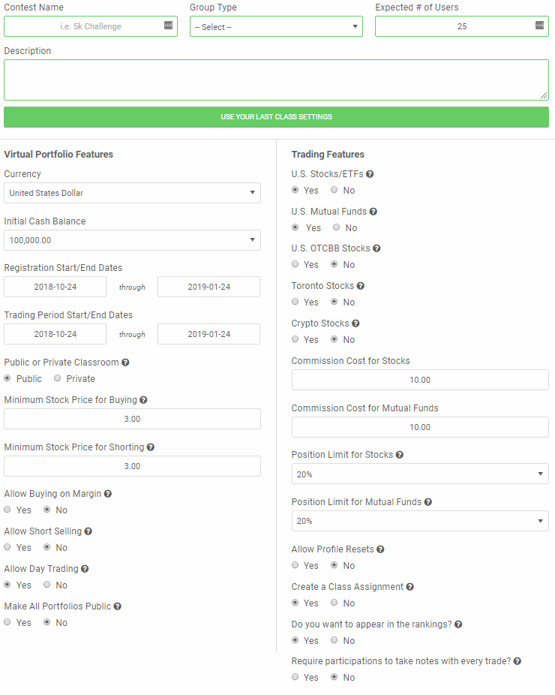
First Step:
Teachers create a custom stock market contest for their class.

Slide 37
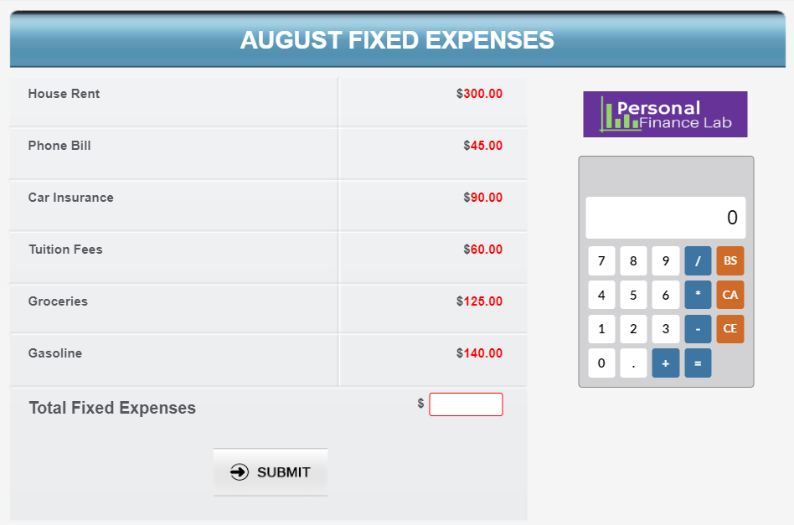
Second Step
Teachers create a custom personal budget contest for their class.

Slide 38
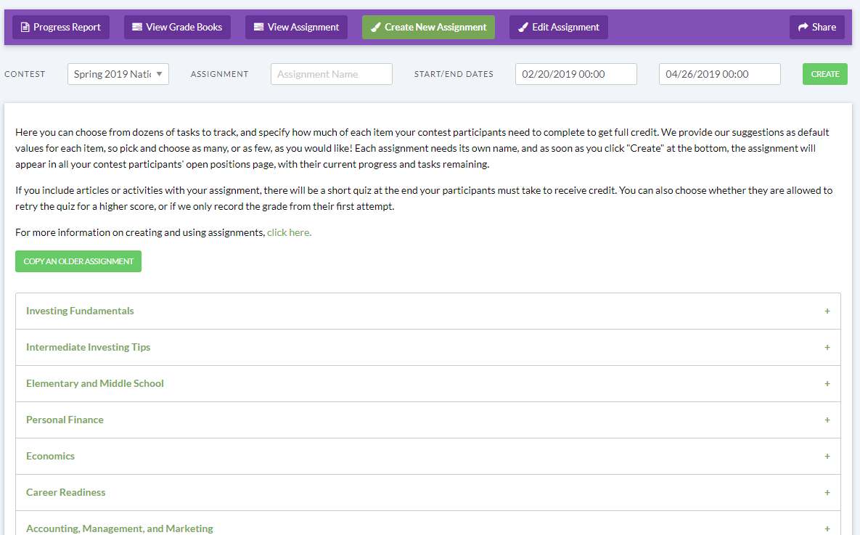
Third Step:
Create a Custom Assignment for Your Class by selecting from our 300+ embedded lessons, grouped by category for easy access

Slide 39
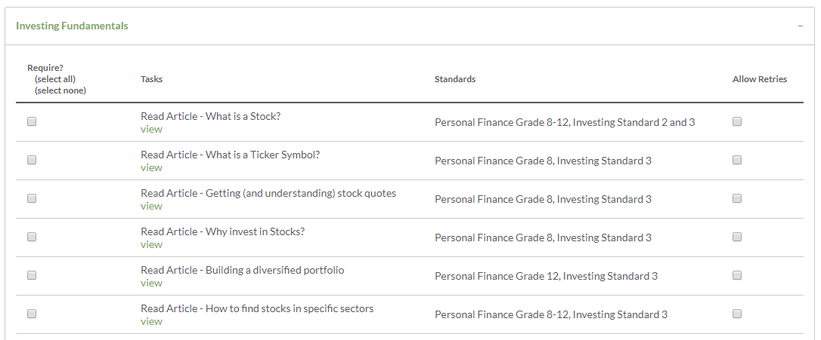
Third Step:
Lessons include, articles, videos, interactive calculators, and more.
Grading can be based on first try, or let students keep trying for higher scores

Slide 40
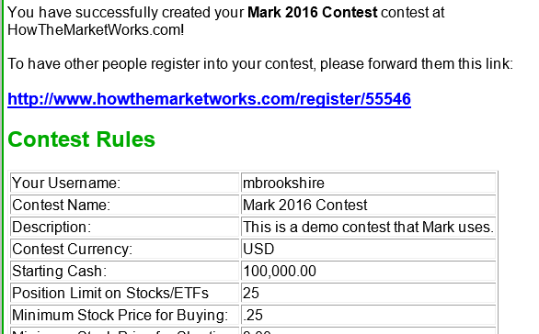
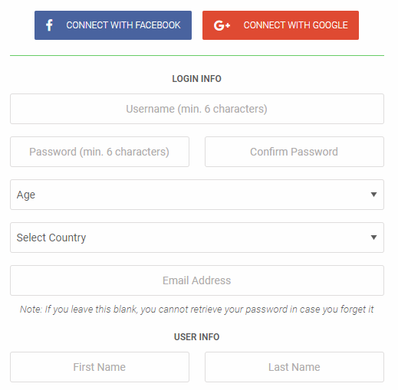
Fourth Step:
Students register by clicking on a link that ties them to your class OR teacher generates logins
Student registration is clean and simple. Students don’t have to enter an email address (and compatible with Google Classroom sign-on!).

Slide 41
Fifth Step:
When students login, they see both their stock portfolio performance and their progress through the Assignments.

Slide 42
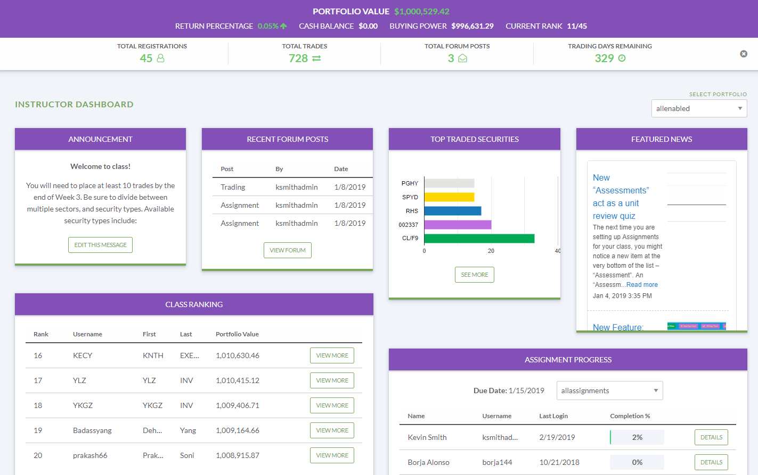
Fifth Step:
Teacher View – instant access to class activities, progress, and reports

Slide 43
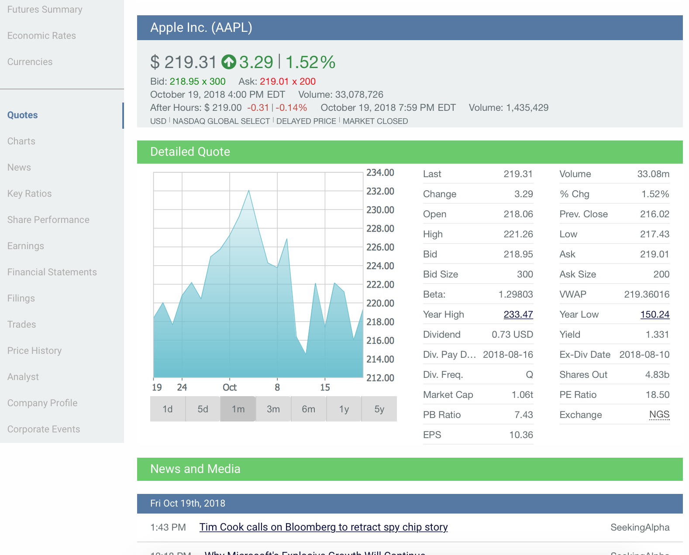
Our Site is Complete with Stock Market Research Tools:
Quotes
Charts
News
Financial Statements
Analysts Ratings
A total of 23 data points per stock

Slide 44
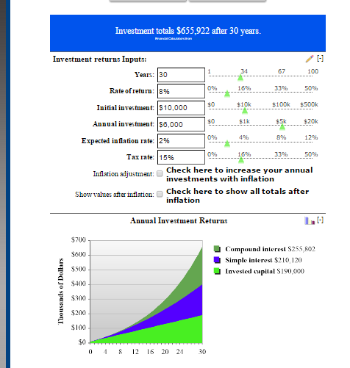
Personal Finance Calculators
We have a complete library of personal finance calculators:
Compound interest
Advanced investment that factors in inflation and taxes
How old will I be when I become a millionaire?
Rent vs buy a house
CALCULATORS ARE INTERACTIVE—SLIDE INPUTS AND WATCH GRAPHS CHANGE!

Slide 45
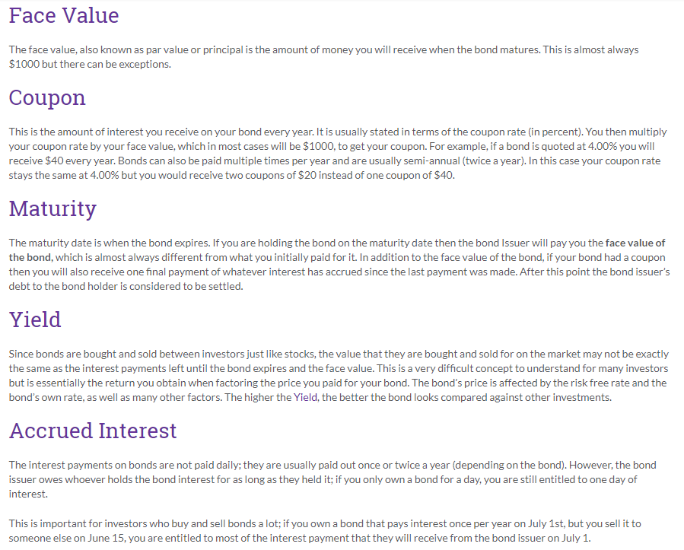
Example Lesson:
What is a Bond?
Lessons explain topics in a clear, concise format.
Key terms and concepts are laid out in 2000 words or less: 5-12 minutes each
Lessons supplemented by videos, infographics, mini-games, and built-in assessments

Slide 46
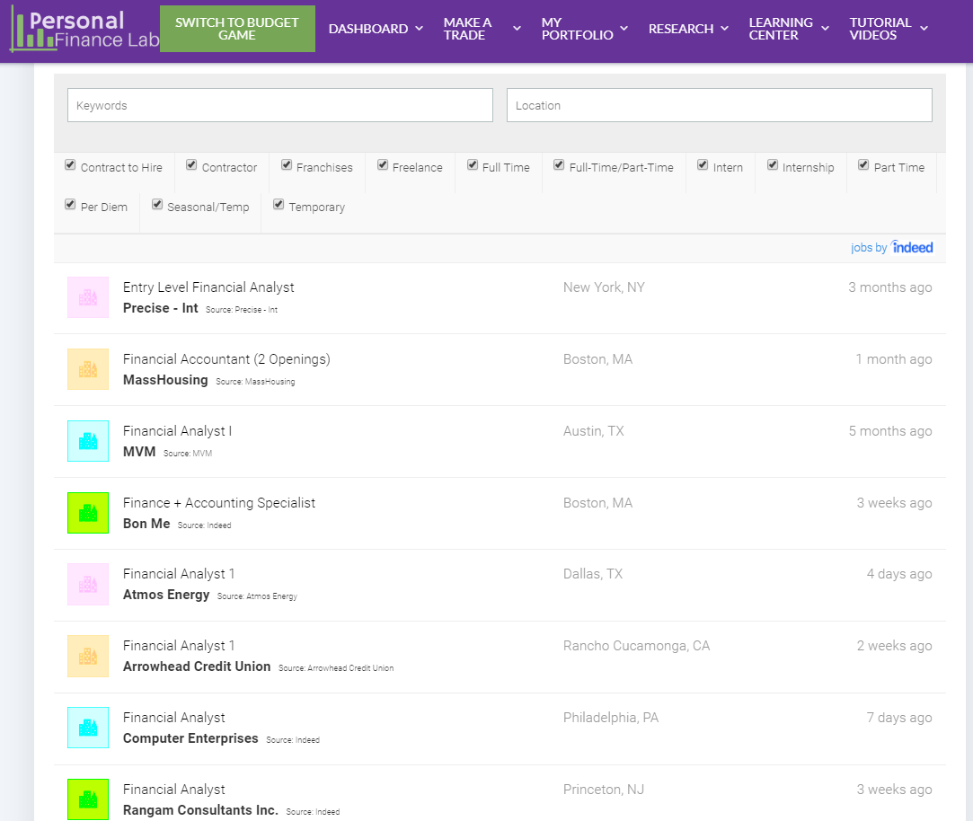
Career Center
Complete Career Center for career development classes CTE programs
Resume and cover letter tips, information on certifications in the finance industry
Job and internship database – over 300,000 REAL job and internship postings!
Students can apply directly, or use the tool for career planning (find dream job, work backwards)

Slide 47
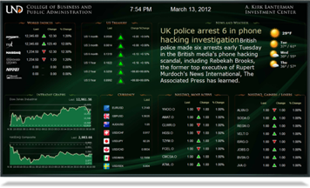
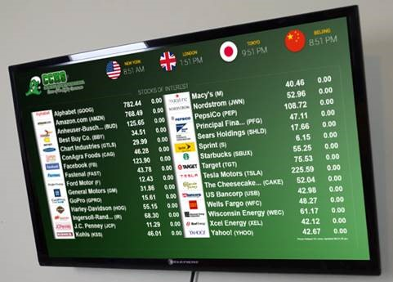
Hardware: LCD Screens
Displays are programmed by the minute to display relevant data to the subject being taught. Data license required.
Notes:
Stock games are not in a vacuum. The reason we keep up with all these trends is because we’re excited to see how our tools are used, why they work, and encourage more schools to get involved.
What we have been working on is taking all of these best practices and lessons learned, and building it directly into the stock game, so teachers can skip all the heavy lifting.
The first way we do this is putting the note-taking directly into the trading flow. Teachers can require students to take notes with every trade explaining their rationale, and relate these decisions back to classroom topics. Students and teachers can both see their trading diaries, which is an excellent way to get started on end-of-semester reports relating each decision back to class.
Students can never edit their notes, but they can add more later to old trades

Slide 48
Hardware: LED Tickers
Providing:
Quotes & Logos
Headline News
Class Rankings
School News
Date/Time
Weather
- Controller allows Ticker to be Plug-n-Play - $499 Data License Required Per Device
- Requires only ethernet connection and standard 120V plug
8 foot Easy Ticker ($4500) + Shipping ($650) | 1 | $ 5,150.
16 foot Easy Ticker ($8750) + Shipping ($950) | 1 | $ 9,700.
Notes:
Stock games are not in a vacuum. The reason we keep up with all these trends is because we’re excited to see how our tools are used, why they work, and encourage more schools to get involved.
What we have been working on is taking all of these best practices and lessons learned, and building it directly into the stock game, so teachers can skip all the heavy lifting.
The first way we do this is putting the note-taking directly into the trading flow. Teachers can require students to take notes with every trade explaining their rationale, and relate these decisions back to classroom topics. Students and teachers can both see their trading diaries, which is an excellent way to get started on end-of-semester reports relating each decision back to class.
Students can never edit their notes, but they can add more later to old trades

Slide 49
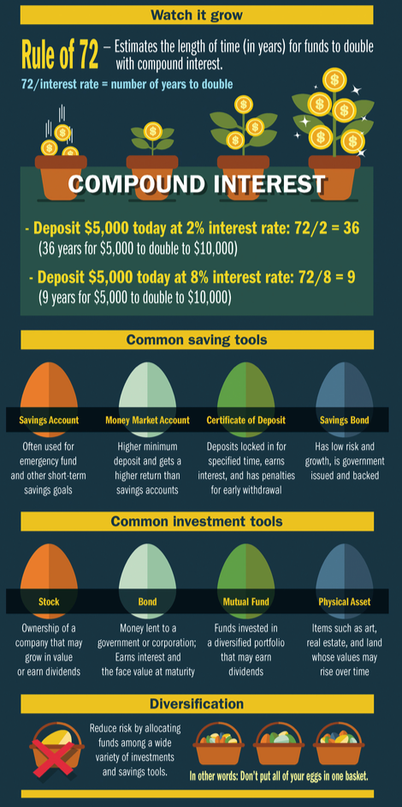
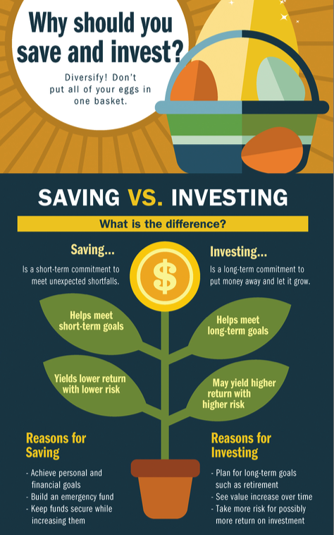
Hardware: Posters
Free Posters
www.FRBAtlanta.org/education/
10”x40”
Notes:
Stock games are not in a vacuum. The reason we keep up with all these trends is because we’re excited to see how our tools are used, why they work, and encourage more schools to get involved.
What we have been working on is taking all of these best practices and lessons learned, and building it directly into the stock game, so teachers can skip all the heavy lifting.
The first way we do this is putting the note-taking directly into the trading flow. Teachers can require students to take notes with every trade explaining their rationale, and relate these decisions back to classroom topics. Students and teachers can both see their trading diaries, which is an excellent way to get started on end-of-semester reports relating each decision back to class.
Students can never edit their notes, but they can add more later to old trades

Slide 50
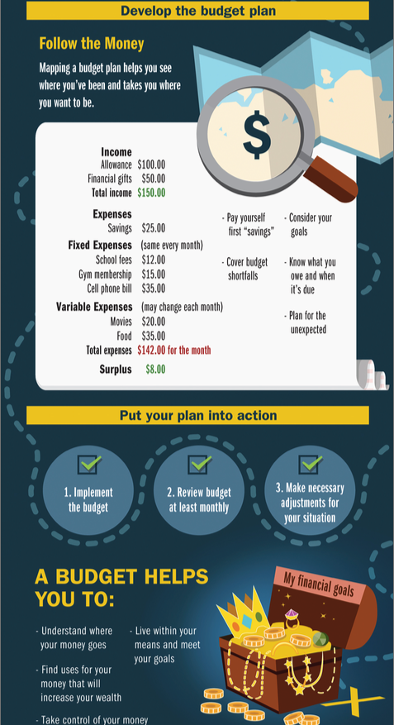
Free Posters
www.FRBAtlanta.org/education/
10”x40”

Slide 51
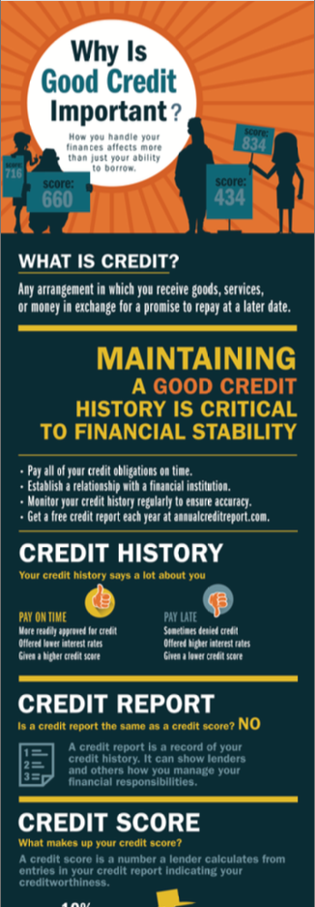
Free Posters
www.FRBAtlanta.org/education/
10”x40”

Slide 52
”It has completely transformed the learning experience!
Students love it and I am thrilled with the increased level of student engagement.”
Quote from Instructor

Slide 53
How To Get Your Lab Started…
STEP 1: Start Planning and Budgeting
Identify what subjects and student clubs can use the lab
Evaluate walls, ceiling, windows, electricity and internet access for ticker and board placement
Get Quotes from vendors
Prepare grant/budget requests. Investigate funding opportunities such as CTE/Perkins funds, local bank sponsorships, donorschoose.org
Take advantage of FREE resources:
Use HowTheMarketWorks.com stock game with sample curriculum
Request FREE posters from the Federal Reserve and FREE Workbooks from NEFE.org

Slide 54
How To Get Your Lab Started…
STEP 2: As Funds Become Available, UPGRADE!
Upgrade to PersonalFinanceLab.com Site License ($1,595/year for up to 100 students)
Access full Business, Personal Finance, Economics curriculum
More robust stock game with stocks, bonds, mutual funds, options, commodities, forex, and cryptos
Personal Budgeting Game only on PersonalFinanceLab.com
Configure existing LCDs to display financial data and class rankings (data license of $360 for up to 3 devices)

Slide 55
How To Get Your Lab Started…
STEP 3: As More Funds Become Available, Finish Your Full Lab
Add the scrolling stock ticker
16 feet of ticker is about $10k with a $499 annual data license
Replace existing LCD screens with larger, commercial grade screens to avoid burn-in
A few $100s more than BestBuy, but worth it.
Upgrade PersonalFinanceLab.com license for multiple class subjects.
Run student investing challenges for prizes and require lessons

Slide 56
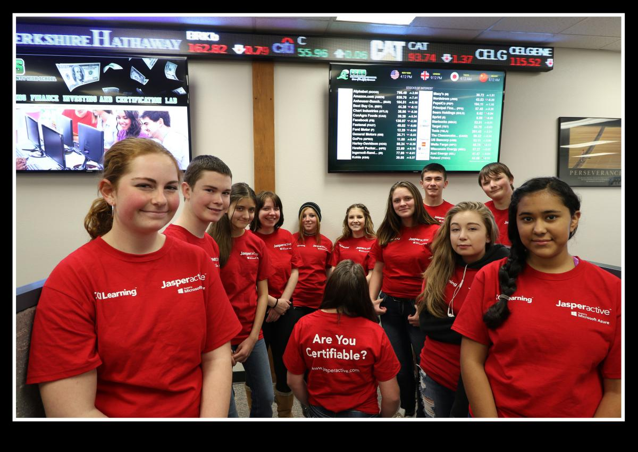
And be greeted each day you walk to the classroom with this!

Slide 57
Join the demo!
Content.PersonalFinanceLab.com/demo

