Slide 1
Buying a Car
Personal Finance Lab

Slide 2
Buying a Car 101
Why is it Important?
Buying a car might be the first big purchase that you make on your own. It is important to go into the process knowing all of the costs that come with owning a car and creating a plan on how to remain fincaniling secure while doing it.
This presentation will break down the costs and steps that come with purchasing your first, second or even third car.

Slide 3
Establishing a Budget for Buying a Car
What's Included
Unlike other small purchases, when thinking about purchasing a car, you should think about the price before thinking about the car you want to buy.
Your budget needs to factor in the life of the car’s loan, the interest rate you pay, and the cost of insurance. Most of these factors are negotiable, so a key is establishing your hard limits before you walk into a dealership.
Car Loan Life And Interest Rate
Car dealers want to try to make cars seem as affordable as possible, so their negotiation point is usually the monthly payment, but smart shoppers know this is just a distraction. By increasing the lifespan of your loan which will equate to a larger overall payment.
You should have two budget prepared. One is for the total cost of the car (including all interest payments over the life of the loan), and the other is how much you can afford in monthly payments.
Insurance
All cars are required to be insured and you can quickly find the cost to insure your car on comparison websites.

Slide 4
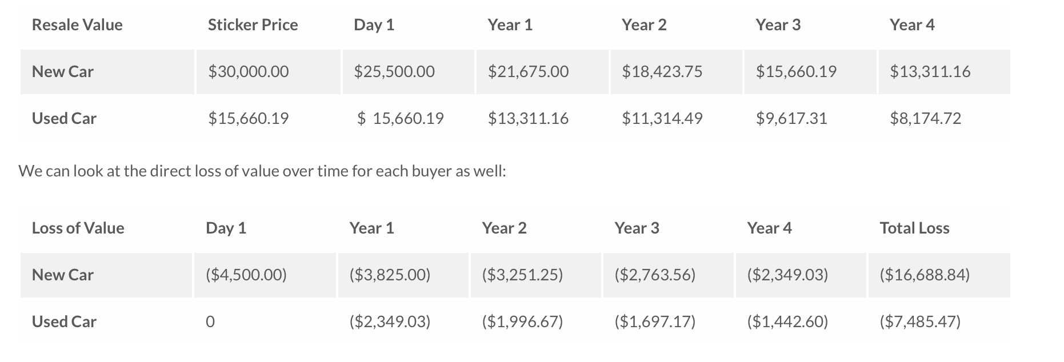
New vs Old
Depreciation and Resale
Cars lose value over time but at varying rates, this is known as depreciation
Let's look at an example of two of the same cars:
As you can see the new car depreciates at a faster rate than the used car.
Why do you think that is?

Slide 5
New vs Old
Financing Charges
It is a lot easier to find more flexible financing for new cars (lower interest rates)
Reliability and Warranties
New cars will almost always have a manufacture warranty. A manufacture warranty covers nearly all repairs, replacements, and any mechanical problems with the car for the first three years. A used car will not have a manufacture warranty.
Technologies and Mileage
New cars will have better technology such as better crash resistance or better gas mileage.
Gas mileage means that per gallon of gas you get X amount of miles

Slide 6
The 4 Square Presentation

Slide 7
Trade In vs Selling
Most people trade in their car when buying a new one but you have the option to sell your car
When to Sell on Your Own
If you have a car that is in good condition and is a popular model, you will most likely have an easy time selling your car and make more money than you would have if you traded it in.
When you sell your car yourself you get to keep all of the money since there is no middle man.
When to Trade In
If you have a car that is older or that has mechanical issues, it is probably in your interest to trade it in because you don’t have to worry about finding a buyer.

