Slide 1
Compound Interest & The Rule of 72
How to Make Your Money Work for You

Slide 2
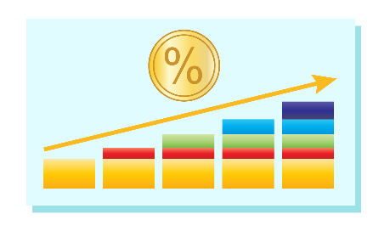
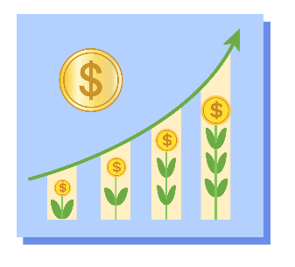
The Two Ways Money Grows
Simple Interest
Like a slow and steady drip
Compound Interest
Like a snowball rolling downhill
Notes:
Let's say you save $1,000. Your piggy bank is one option. After 10 years, you still have $1,000. A bank account is better—it pays interest. But there are two very different ways interest can work.

Slide 3
Simple Interest: The Slow Drip
You invest $1,000 at a 10% simple interest rate:
Year 1: You earn $100 in interest.
Total = $1,100
Year 2: You earn another $100.
Total = $1,200
Year 3: You earn another $100.
Total = $1,300
Notes:
Interest is paid only on the original amount you saved (the "principal").

Slide 4

Compound Interest: The Snowball Effect
Small snowball → Larger snowball → Even larger snowball
Notes:
Interest is paid on your principal PLUS all the interest you've already earned. Your interest starts earning its own interest. This is the single most powerful force in personal finance. Let's see it in action.

Slide 5
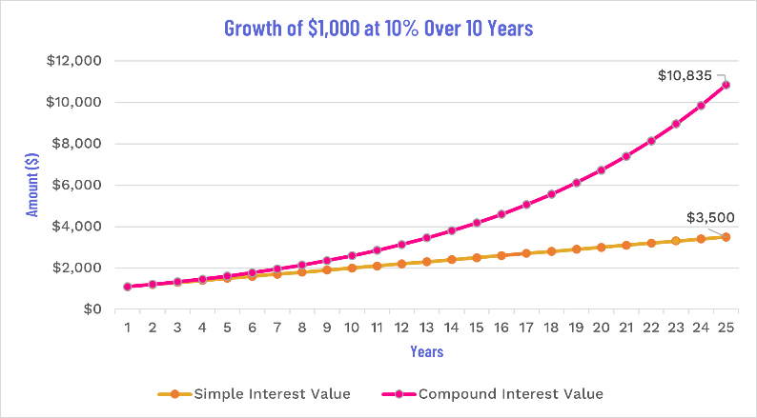
The Impact of Time
Notes:
The difference between the two is small at first but grows exponentially over time. This is the power of compounding—earning interest not just on your initial principal, but on the accumulated interest as well.
After 25 years with Simple Interest, you have $3,500.
After 25 years with Compound Interest, you have $10,834.71.

Slide 6
The Rule of 72
Want a quick way to estimate how long it takes to DOUBLE your money?
72 ÷ Interest Rate = Years to Double
Notes:
This is one of the most useful mental math tricks in all of finance. This means at a 10% compound interest rate, your money will roughly double every 7.2 years. If you look back at the previous slide, you'll see that at the end of year 7 the value was $1,948.72 and at the end of year 8 it was $2,143.59. So, 7.2 years is a good estimate for when it would cross the $2,000 mark. It's not exact, but it's incredibly close. Let's try it.

Slide 7
Let’s Practice
If your Stock Game portfolio is earning an average of 8% per year, how long will it take your money to double?
Notes:
72 / 8 = 9 years

Slide 8
Let’s Practice
If you want to double your money in just 6 years, what annual rate of return do you need?
Notes:
72 / 6 = 12%

Slide 9
Let’s Practice
Your savings account in the Budget Game pays 2% interest. How long will it take to double?
Notes:
72 / 2 = 36 years
Key teaching moment: Saving vs. Investing — Notice the dramatic difference between the time needed at 2% (36 years) versus 8% (9 years)

Slide 10

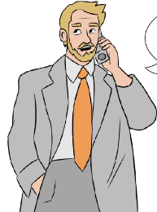
A Tale of Two Investors
Early Tia
Late Eric
Stars at age 25
Invests $5,000/year for 10 years ONLY
Stops adding money at age 35
Total Money Invested: $50,000
Starts at age 35
Invests $5,000/year for 30 years
Invests until age 65
Total Money Invested: $150,000
Notes:
Who do you think ends up with more at age 65?

Slide 11
How to Calculate Future Value
Formula: FV = PMT * [((1 + r)^t - 1) / r]
FV = Future Value
PMT = Annual Payment ($5,000)
r = Annual interest rate (0.09)
t = Number of years (30)
Notes:
Key Assumptions
Principal (PMT): $5,000 invested annually.
Annual Interest Rate (r): 9% (or 0.09 as a decimal).
Interest is compounded annually.
Eric’s Calculation
FV = 5000 * [((1 + 0.09)^30 - 1) / 0.09]
FV = 5000 * [((1.09)^30 - 1) / 0.09]
FV = 5000 * [(13.2677 - 1) / 0.09]
FV = 5000 * [12.2677 / 0.09]
FV = 5000 * 136.3075
FV ≈ $681,537
Tia’s Calculation
FV = 5000 * [((1.09)^10 - 1) / 0.09]
FV = 5000 * [(2.3674 - 1) / 0.09]
FV = 5000 * [1.3674 / 0.09]
FV = 5000 * 15.1929
FV ≈ $75,965 (This is her balance at age 35)
Now we use the standard Compound Interest formula (or Future Value of a Single Sum) because she isn't adding any more money.
FV = 75,965 * (1 + 0.09)^30
FV = 75,965 * (1.09)^30
FV = 75,965 * 13.2677
FV ≈ $1,007,935

Slide 12
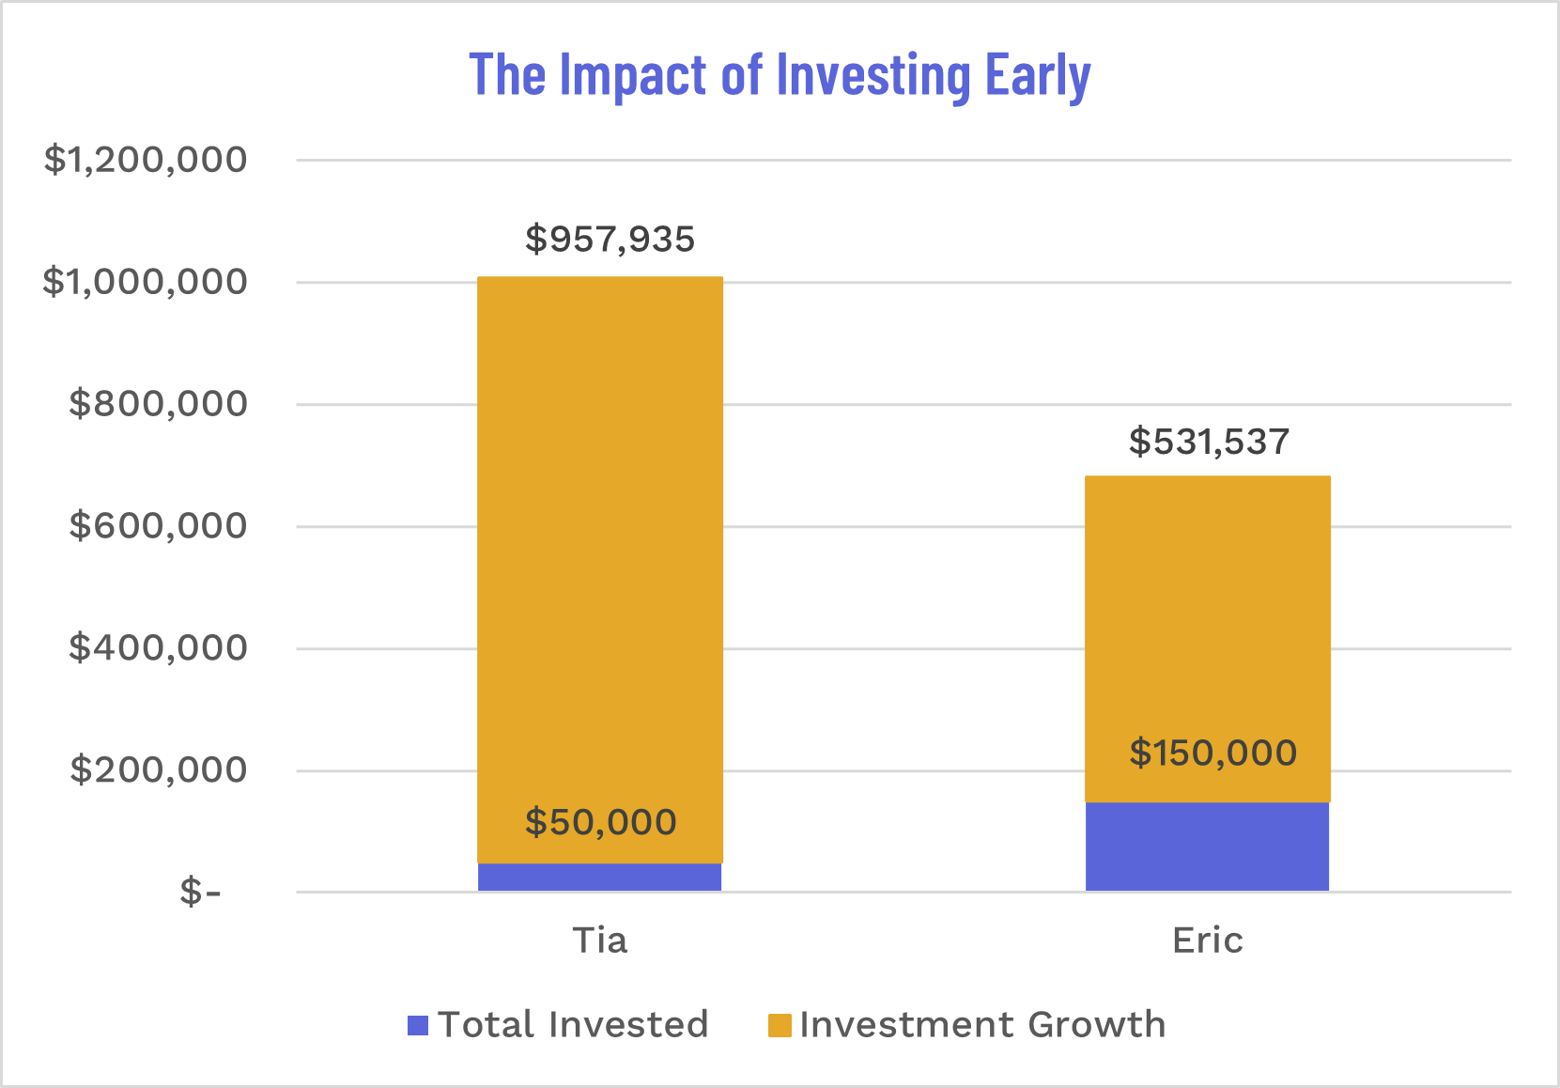
Your Most Valuable Asset is Time
Tia invested $100,000 less, but ended up with $326,000 MORE.
Net Worth at 65
Tia: $1,007,935
Eric: $681,537
Notes:
As you can see, Tia ends up with just over one million dollars. While Eric, despite investing for 30 straight years, ends up with around $681,000. Tia’s greatest advantage wasn't how much she saved, but WHEN she started. The first decade of investing did more work than the next 30 years combined.
Eric invested three times more money—$150,000 compared to Tia's $50,000.
Look at the two bars. The purple section is the money they put in themselves. The orange section is pure investment growth—their money working for them.

Slide 13
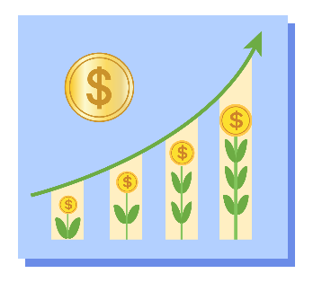
Key Takeaways
Compound interest makes your money grow exponentially.
The Rule of 72 is your shortcut to estimate growth.
Starting early is the single most important factor in building wealth.
Notes:
Now that you understand the theory, it's time to apply it. First, use the “Watch How Your Savings Could Grow Calculator" to see how these rules apply to your personal goals. Then, analyze your own Stock Game portfolio to see compounding in action

