Slide 1
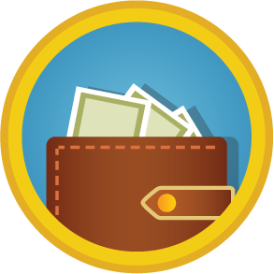
Credit Reports
Personal Finance Lab

Slide 2
Credit Reports 101
What?
A credit report, at its core, is a document that keeps a record of (most) of your regular bill payments. Your credit report includes things related to credit history, criminal records, bankruptcies and lawsuits.
Why?
Your credit report is important to know about because when you take out a loan, apply for a credit card, rent a home and many other things they may request for a copy of your credit report.
This is used to verify how reliable you are for paying your bills on time.

Slide 3
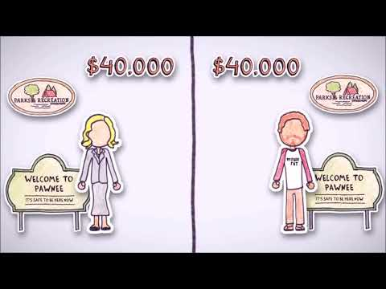
Credit Report vs Credit Score
Your “Credit Report” is a complete credit history, meaning the bills you have paid (or didn’t pay), and their amounts.
Your “Credit Score” is a single number that is a summary of all the things in your credit report.

Slide 4
When is a Credit Report Important?
Applying for a Credit Card
When you apply for a credit card, your credit report will affect your spending limits, interest rates, and overall trust.
Applying for a Mortgage
When you apply for a mortgage, your credit report will affect if the bank even gives you a mortgage, your interest rate and down payment.
Renting an Apartment
When you rent an apartment, your credit report will affect if the leaser lets you rent and your security payment.
Getting Insurance
When you get insurance, your credit report will affect your premiums and deductibles.
Applying for a Job
This is more common in the finance and baking industry but, it is spreading to different industries. The purpose is to check your overall professional trustworthiness.

Slide 5
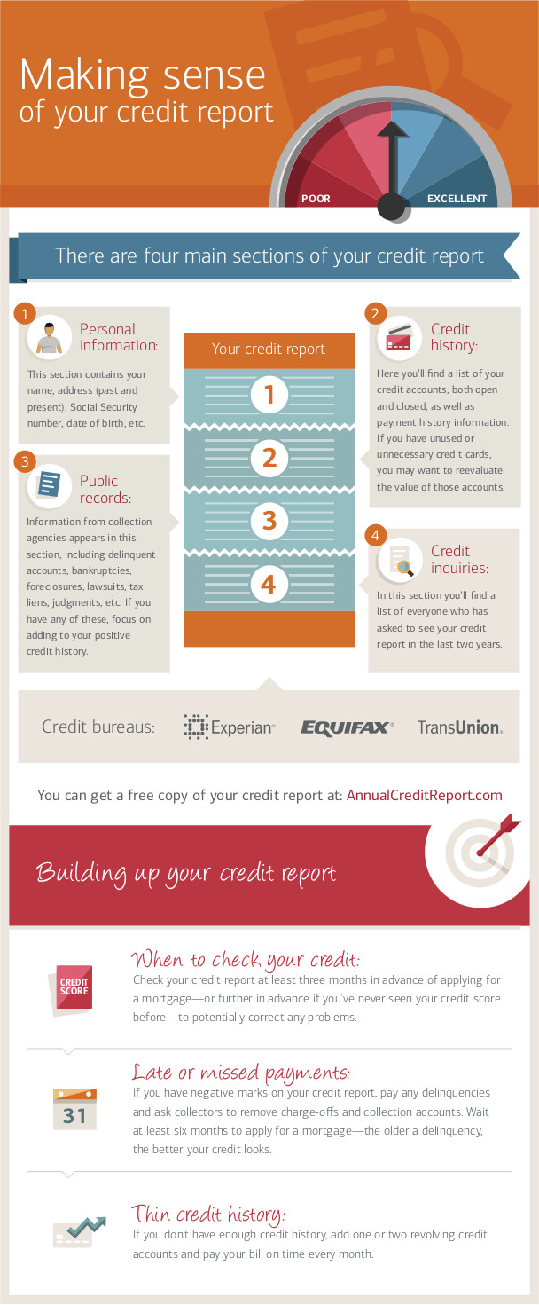
What’s in a Credit Report?
Credit Card Payments
Cell Phone Payments
Cable/Internet Payments
In-Store Financing For Large Purchases
Unpaid Parking Tickets
If You Have Been Sued
Any Other Outstanding Debt
Mortgage Payments
Rent
Utilities (Gas, Phone, Water)
Car Payments
Unpaid Taxes
If You Have Declared Bankruptcy
Pay Day Loan Payments
This information gets into your credit report for the creditors. Which means that everything is from someone else. Not every creditor supplies this information

Slide 6
Fair Credit Reporting Act
Consumer Rights
If you think that there is an error on your credit report, you have the right to dispute (try to get it removed) it.In this process you must contact the credit report company and the business who filed the claim. An example is that you did not pay your utilities when you moved out of a house and then you pay it and get it off your report.
User Responsibilities
If a business requests your credit report, they must:
Only use the report for deciding the terms of your financial agreement
Notify someone if something in their credit report affected their final decision
Tell the consumer which company they got the report from so the consumer can verify it.
Data Providers Responsibilities
The data providers must make sure that all the information is accurate and up to date. They must also protect you report from data thiefs.

