Slide 1
Essential Tax Forms
A Guide for Employees and Contractors

Slide 2
Key Tax Forms
Why It Matters
What They Are
From getting hired to filing taxes, your entire financial year is tracked on just a handful of forms.
Understanding them is the key to getting paid correctly and avoiding surprises at tax time.
For Employees:
W-4 Form: You fill this out when hired.
W-2 Form: Your annual earnings summary.
For Contractors/Gig Workers
W-9 Form: You provide this to clients to get paid.
1099-NEC Form: Your annual contractor earnings.
For Everyone
Form 1040: The final tax return you file with the IRS.
Notes:
Think of these forms like a recipe. The W-4, W-2, and 1099s are your ingredients, and the Form 1040 is the final dish you serve to the IRS. If you understand your ingredients, you'll have no problem at the end of the year. Knowing what these forms do puts you in control and helps prevent nasty surprises, like an unexpected tax bill.

Slide 3
The Lifecycle of Your Tax Documents
Step 1. Getting Hired: You tell your employer how to pay you. (W-4 form & W-9 form)
Step 2. Getting Paid: You receive your earnings. (Pay Stub)
Step 3. Year End: You receive a summary of your earnings.
(W-2 form & 1099 form)
Step 4. Tax Time: You report everything to the IRS. (1040 form)
Notes:
Before we dive into the details of each tax form, let's look at the big picture. This is the journey your money and your documents take from your first day at a job to the day you file your taxes.
Step 1 is 'Getting Hired.' This is Day One. Before you even earn your first dollar, you have to give instructions to your employer or client. For a regular job, that's your W-4 form, where you tell your employer how much tax to set aside for you. For a freelance gig, it's the W-9 form, where you give the client your info so they know who to pay. This step is all about setting up the rules.
Step 2 is 'Getting Paid.' This is the part you see all year long. Every time you get a paycheck, you also get a pay stub. This is your real-time receipt, showing what you earned and what was taken out. It’s the direct result of the instructions you gave back in Step 1.
Step 3 is 'Year End.' After the calendar flips to a new year, you get a summary of your earnings for the previous year. In January, your employer will send you a W-2 form, and any clients who paid you will send a 1099 form.
Step 4 is 'Tax Time.' This is the final chapter. You take your summary documents from Step 3—your W-2s and 1099s—and you use them to fill out your tax return, the Form 1040. This is where you settle with the government and find out if you get a refund or owe more money.

Slide 4
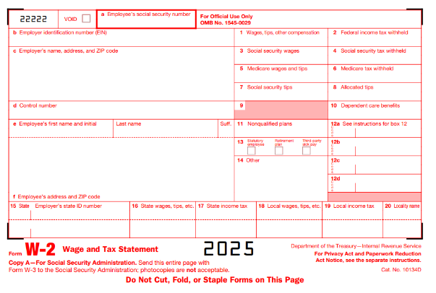
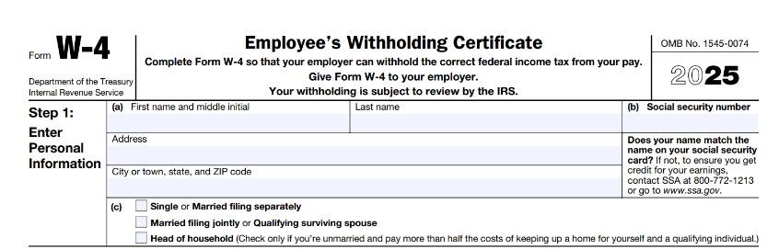
Employee Tax Forms
W-4 Form
W-2 Form
Tax instructions for your employer.
Tells your employer how much tax to withhold from each paycheck.
Affects your take-home pay throughout the year.
Your annual “receipt” from your employer.
Shows total gross income and taxes withheld.
You receive it in January.
Notes:
Link to W-4 Form: https://www.irs.gov/pub/irs-pdf/fw4.pdf
Link to W-2 Form: https://www.irs.gov/pub/irs-pdf/fw2.pdf
If you're a regular employee, you fill out a W-4 to tell your boss how much tax to take out of your pay. This will also include details of your filing status (e.g., single, married filing jointly, head of household), you can claim children and other dependents to reduce withholding.
Next, you have your 'year-end receipt'. As an employee, you get a W-2 that summarizes everything you earned and all the taxes you already paid.

Slide 5
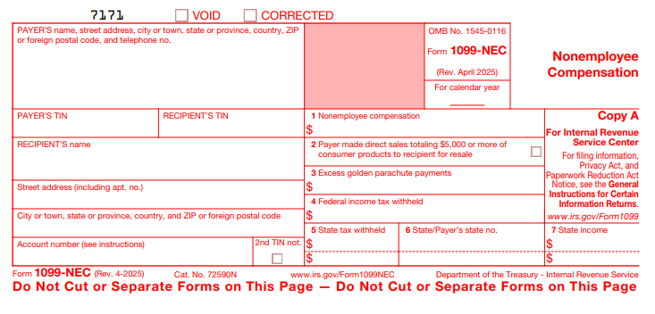
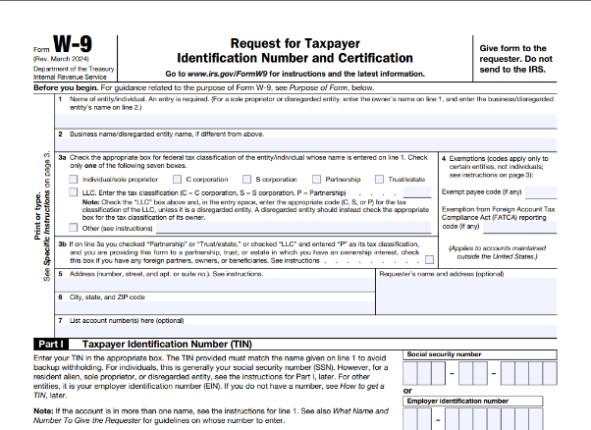
Contractor Tax Forms
1099-NEC
W-9 Form
Simple form showing how much a company paid you.
No tax information is included.
Contractors are responsible for calculating and paying their own taxes.
You receive it in January.
The form you give to a client before you start working.
Provides your legal name, address, and Taxpayer ID Number.
It’s the contractor’s equivalent of a W-4, but no taxes are withheld.
Notes:
Link to W9-Form: https://www.irs.gov/pub/irs-pdf/fw9.pdf
Link to 1099-NEC: https://www.irs.gov/pub/irs-pdf/f1099nec.pdf
If you're a contractor or freelancer, you give your client a W-9 so they have your info to pay you. As a contractor, you get a 1099-NEC in January showing what you were paid the previous year. No taxes are taken out of that 1099 income.

Slide 6
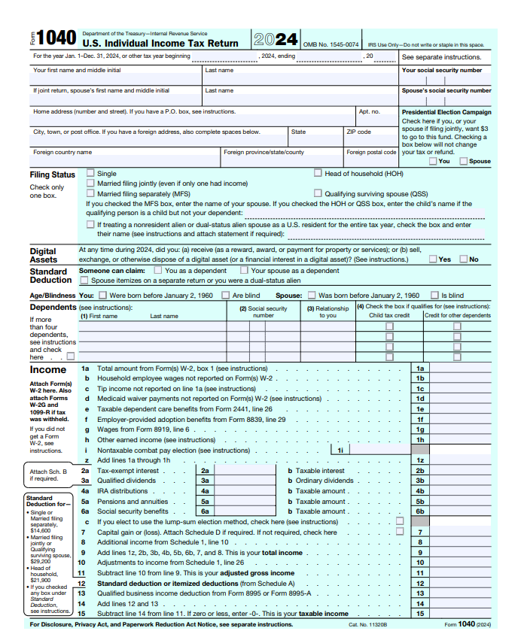
Form 1040
This is this Individual Income Tax Return.
It's the primary document you send to the IRS every April.
You use information from your W-2s and 1099s to fill this out.
It calculates your total tax for the year and determines if you get a refund or if you owe more money.
All other forms are just inputs; the 1040 is the final product.
Notes:
Link to 1040 Form: https://www.irs.gov/pub/irs-pdf/f1040.pdf
Form 1040 is the standard document that all U.S. individuals use to file their annual federal income tax return. On this form, you report your total income for the year from all sources, such as wages, investments, and self-employment.
It is also used to apply deductions and credits, which lower the amount of your income subject to tax. The final calculation on the form determines if you will receive a tax refund or if you owe an additional balance. This form must be filed with the IRS by the annual tax deadline, typically April 15th.

Slide 7
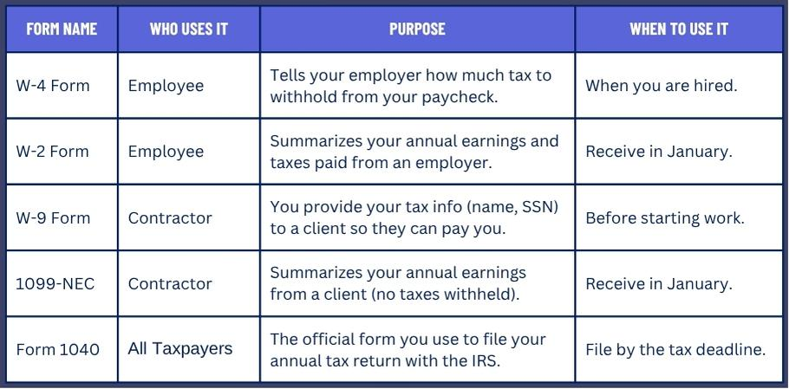
Summary of Key Tax Forms
Notes:
Think of it like this:
The W-4 and W-9 are for setup – telling people how to pay you.
The W-2 and 1099 are your summaries – showing what you earned over the year.
And the 1040 is your final report – where you put everything together for the government.

