Slide 1
Teaching Investing with the Stock Game
An introduction to the PersonalFinanceLab® Stock Game

Slide 2
Presenter
Kevin Smith
PersonalFinanceLab Director of Product Development

Slide 3
What is a Stock Game?
Students in a class get “Practice Cash” to learn how to invest
Students build and manage a portfolio over the course of weeks or months
Rules for what, and how, students invest are usually determined by the teacher

Slide 4

The PersonalFinanceLab Stock Game
Top-of-the-line portfolio simulation, based on the StockTrak university investing platform
Tons of settings allows a lot of flexibility, with lots of built-in tools to make life easier for students too
Live support available for teachers and students!

Slide 5

Research Tools
More than just a practice portfolio – built in tools to make sure students are actually learning!

Slide 6


Research Tools
Automatic Tutorials and Tours
Charts and Research at Trading
Assign tutorial videos for students to watch before getting started
Automatic guided tours launch the first time students arrive in their portfolio
Automatic symbol lookup built into trading system
Charts, analyst ratings, and more load automatically – no running around the internet to find basic information!

Slide 7

Research Tools
Built-In Research Center
Stock Comparison Tool
Detailed quotes, price histories, analyst ratings, financial statements and more
Fund analysis, composition, and more for mutual funds and ETFs too
Integrated stock screener and more trading ideas
Interactive exercise introducing students to “what matters” when looking at a quote, and how to make a decision between investments
Includes an export for future reference

Slide 8

Assignments
Assigned reading, tutorials, and required trades you can give your students
You can even give students cash rewards to their portfolio by completing their assignments on time

Slide 9

Making Trades
Quick walkthrough of building a portfolio of stocks, bonds, mutual funds, and cryptocurrencies

Slide 10

Session Rules
Trading dates
Security types
Diversification Limits
Margin Trading
Interest on Cash
Whitelist/Blacklists
…And more!

Slide 11

Reports and Rankings
Keeping engagement high – and keeping teachers in control

Slide 12
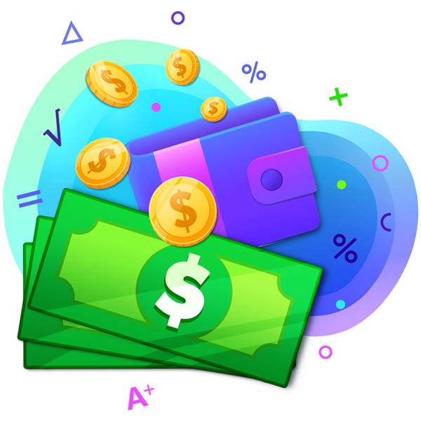
Sample Game Scenarios
Classic
Modern
$100,000 starting cash
Equities, mutual funds, and bonds
20% Position Limit
No day trading, short selling, margin trading, fractional trading
$3 minimum stock price
$1,000 starting cash
Equities, funds, bonds, and crypto
20% Position Limit, 80% Diversification Limit
YES to day trading, short selling, margin trading, and fractional trading
$3 minimum stock price

Slide 13

Sample Game Scenarios
Teams
Retirement Account
Classic or Modern starting position
Students grouped into teams
Each student manages their own portfolio, but their holdings get aggregated into a Team Portfolio for Team Ranking
Team rankings are based on % return
$500 starting cash
No position limits
“Weekly Deposit” of $100 added to all student accounts every Monday to be continuously invested
Position limits may be added part-way through the semester

Slide 14

Sample Game Scenarios
Long Game
Budget Game Combo
Instead of a 6-10 week game, extend to 52 weeks
Students encouraged to continuously monitor and build their portfolio over a longer time period
Depends on ability of teacher to follow up with students
If using our Budgeting Game, start with $1 starting cash
Students build their Stock Game portfolio by transferring money from their Budget Game savings
Otherwise follow “Modern” rules

Slide 15

How Do I Grade This?
Grading rubrics, lesson plans, and more!

Slide 16

Get In Touch!
Contact us at info@personalfinancelab.com to connect with the account manager from your area
Contact me at kevin@personalfinancelab.com

