Slide 1
Preparing Your First Tax Return
A Beginner's Guide to Filing Statuses, Deductions, and Tax Preparation Options.

Slide 2
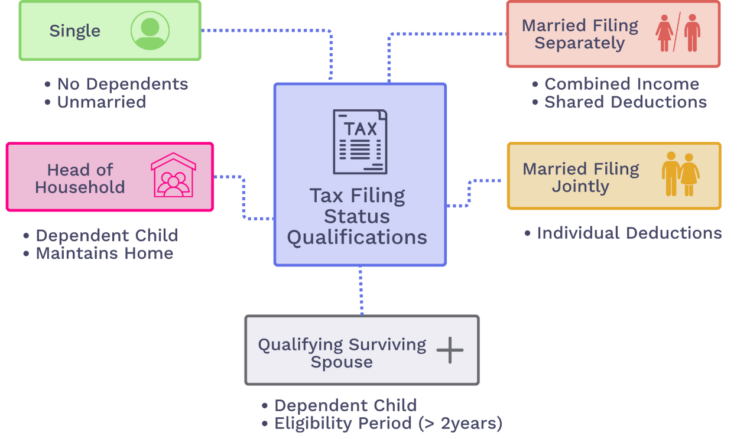
The 5 Filing Statuses
Notes:
Okay, this is the very first decision you make on your tax return: What is your filing status? This choice tells the IRS about your life situation as of the last day of the year, and it's important because it determines your standard deduction amount and your tax brackets. Let's quickly go through them.
The Three Most Common Statuses:
Single: This is the default. If you're not married, this is you. Simple as that.
Married Filing Jointly: If you're married, this is the most common choice. You and your spouse combine all your income and deductions onto one single tax return. Over 95% of married couples file this way because it usually gives you the biggest tax advantages.
Head of Household: Think of it as 'Single with dependents.' If you're unmarried but are paying more than half the bills to support someone living with you, like a child, you can use this status. It's a huge benefit because you get a bigger standard deduction and better tax rates than if you just filed as Single.
The Two Special Cases:
Married Filing Separately: This is the opposite of filing jointly. It's very rare because it's usually the worst option—it often disqualifies you from valuable tax credits and deductions. People typically only use it in very specific legal situations.
Qualifying Surviving Spouse: This is a compassionate status. It allows someone whose spouse has recently passed away to keep the benefits of filing jointly for two years, as long as they have a dependent child.
For most of you starting out, you'll almost certainly be using Single, or maybe Married Filing Jointly down the road. The key is to know that 'Head of Household' is a major benefit if you qualify for it.

Slide 3
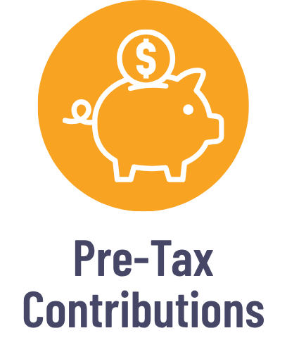

Your Goal: Lowering Your Taxable Income
Before the government calculates your tax, your goal is to legally reduce the amount of your income that gets taxed.
There are two ways to do this:
Gross Income - (Contributions + Deductions) = Your Taxable Income
Notes:
Before we get into the details, let's establish the most important concept for this entire presentation. You don't pay tax on your total income. You pay tax on your taxable income, which is a smaller number.
Our goal as taxpayers isn't to avoid taxes, but to legally lower our taxable income as much as possible. The tax code gives us two main tools to do this:
Pre-Tax Contributions: These are actions you take throughout the year.
Tax Deductions: This is a choice you make when you file your taxes.
Think of it like a simple formula: Gross Income - (Contributions + Deductions) = Your Taxable Income.

Slide 4

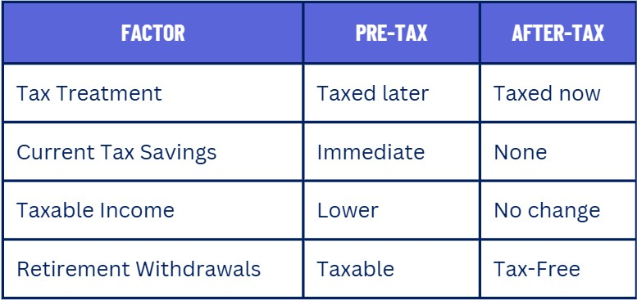
Pre-Tax vs. After-Tax
You’re not avoiding taxes, you’re deciding when you pay them.
Notes:
The key takeaway is you're not avoiding taxes, you're just deciding WHEN to pay them.
Tax Treatment: With Pre-Tax contributions, you get a tax break now. The money is taken out of your paycheck before income tax is calculated. You'll pay taxes on it later, when you withdraw it in retirement. With After-Tax, you get no break now—the money is taxed first, then saved.
Current Tax Savings: Because of this, Pre-Tax gives you immediate savings. Every dollar you contribute lowers your taxable income for the current year.
Taxable Income: Using pre-tax accounts makes the income you report to the IRS lower.
Retirement Withdrawals: This is the trade-off. Decades from now, when you take money out of a Pre-Tax account, those withdrawals will be taxed as regular income. Withdrawals from an After-Tax account, like a Roth, are completely tax-free.

Slide 5




The Benefits of Pre-Tax Contributions
Every dollar you contribute pre-tax is subtracted from your income before the IRS calculates your tax bill.
Because your taxable income is lower, your tax bill for the current year is smaller.
Your take-home pay drops by less than the amount you saved. For example, saving $100 might only reduce your paycheck by about $80.
Your investments grow without being taxed on the gains each year, allowing your money to compound more effectively over the long term.
Notes:
So, why should you care about contributing pre-tax? There are four main benefits that come from using a pre-tax account.
First, it Lowers Your Taxable Income. Every dollar you contribute is subtracted from your gross income before the IRS even calculates your tax bill.
And because your taxable income is lower, the direct result is Immediate Tax Savings. A smaller income number on your tax return means a smaller tax bill for the year. This is saving you get right now.
Then, there's a benefit you'll feel on every single paycheck. It Protects Your Take-Home Pay. Because you're saving money before taxes are calculated, a $100 contribution might only reduce your actual paycheck by about $80. You get to save the full $100, but it costs you less out of your pocket, making it much easier to save for the future.
Finally, there's a long-term benefit: Tax-Deferred Growth. Your money is invested in a kind of tax shelter, where it can grow and compound year after year without you paying taxes on the investment gains. This allows your money to grow much more effectively over the long-term.

Slide 6
Using Pre-Tax Contributions
Traditional 401(k) & IRA Plans
Health Savings Accounts (HSAs)
Reduces current taxable income dollar-for-dollar
Money grows tax-deferred until retirement
Taxes paid when withdrawn in retirement
Annual contribution limits
Requires a high-deductible health plan
Triple tax advantage: pre-tax, tax-free growth, tax-free withdrawals for medical expenses
Funds roll over year to year
Annual contribution limits
Notes:
Let's look at two of the most powerful pre-tax tools you'll encounter in your career.
On the left, we have Traditional Retirement Plans.
These give you your tax break now.
Every dollar you contribute reduces your taxable income for the year.
You don't pay taxes on the growth each year, which lets it compound while you’re working and contributing.
The trade-off is that you'll pay regular income tax on the money when you withdraw it in retirement.
Remember that with a 401(k), you might also get a valuable employer match!
On the right, we have the Health Savings Account, or HSA.
An HSA is often overlooked, but it’s one of the best investment accounts. It has a unique triple tax advantage:
Your contributions are pre-tax, lowering your taxable income now (just like a Traditional IRA/401k).
Your money grows completely tax-free.
Your withdrawals are also completely tax-free, as long as you use them for qualified medical expenses.
Unlike other health accounts like FSAs, the money is yours forever—it rolls over year after year. Many people use it as a secondary, tax-free retirement account for future medical costs. The only catch is that you must be enrolled in a high-deductible health plan to be eligible to contribute.
A Note on Contribution Limits: Both accounts have annual limits on how much you can contribute. These limits change almost every year to adjust for inflation.
Check 401(k) Retirement Plans contribution limits: https://www.irs.gov/retirement-plans/plan-participant-employee/retirement-topics-401k-and-profit-sharing-plan-contribution-limits
Check HSA contribution limits: https://www.irs.gov/publications/p969#en_US_2024_publink1000204046 or https://www.hsacentral.net/consumers/contribution-limits/

Slide 7

Tax Deductions (Standard vs Itemized)
Standard Deduction
Itemized Deductions
A no-questions-asked dollar amount you can subtract from your income.
The amount you get depends on your filing status (Single, Married, etc.).
Simplifies tax filing because you don't need to track individual expenses.
The best choice for most taxpayers.
Specific expenses you can deduct if they exceed your standard deduction:
Mortgage interest
State & local taxes (up to $10K)
Charitable contributions
Medical expenses exceeding 7.5% of AGI
Notes:
Alright, we've covered the first tool—contributions. Now let's look at the second major tool for lowering your taxable income: Tax Deductions. This is a choice you make every year when you sit down to do your taxes. The IRS gives you two options.
The Standard Deduction: This is the easy, automatic option. It’s a fixed dollar amount, no questions asked, that you can subtract from your income. You don’t have to track expenses or keep receipts. Because of its simplicity and size, this is the best choice for over 90% of taxpayers.
Itemized Deductions: This is the 'do-the-math' option. You can add up specific, approved expenses like mortgage interest, large medical bills, and charitable donations.
You choose whichever amount is higher. For most young people without a home, the Standard Deduction is almost always the bigger and better choice.
Find out your up-to-date Standard Deduction: https://www.irs.gov/help/ita/how-much-is-my-standard-deduction

Slide 8
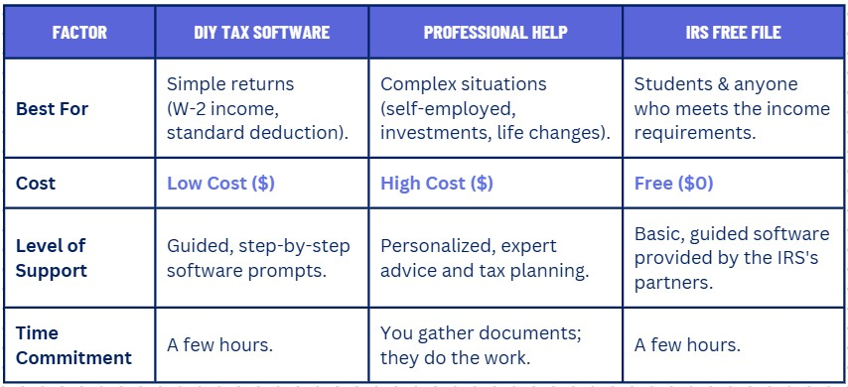
How to File Your Taxes
The best choice depends on your confidence, the complexity of your finances, and your budget.
Notes:
Most people use one of three main methods.
First is DIY Tax Software. This is the most popular option. It guides you through the process like an interview, asking you questions and filling in the forms for you. It's low-cost and perfect for simple situations.
Second is hiring Professional Help, like a CPA. This costs more, but it's the best choice for complex situations—if you're self-employed, have a lot of investments, or went through a major life change. They provide expert advice and can save you money in the long run.
Finally, there’s the IRS Free File. If your income is below a certain threshold—which applies to many students and young people—you can use high-quality tax software from IRS partners for free. It’s the best of both worlds: guided help at zero cost.

Slide 9
Your First Tax Return Checklist
Step 1. Determine Your Filing Status: Single, Married Filing Jointly, Head of Household, etc.
Step 2. Calculate Taxable Income: Start with Gross Income, then subtract Pre-Tax Contributions and your Deductions (Standard/Itemized).
Step 3. Choose How to File: Use software or hire a pro. Consider the complexity of your situation.
Step 4. File By the Deadline: Usually April 15th – avoid penalties and interest by filing on time!
Notes:
Okay, let's put it all together. We've covered a lot, but preparing your tax return really comes down to these four simple steps.
First, Determine Your Filing Status. Who are you to the IRS this year? Single? Head of Household? This sets the foundation for everything else.
Second, Calculate Your Taxable Income. Start with your total earnings, then subtract your pre-tax contributions and your chosen deduction—usually the Standard Deduction.
Third, Choose How to File. Pick your tool: DIY software, professional help, or IRS Free File, depending on your situation.
And finally, File By the Deadline! The deadline is typically April 15th. Filing on time helps you avoid penalties and interest.
If you follow these steps, you'll be able to navigate your first tax return with confidence.

