Slide 1
Saving Toolkit
Your Guide to Financial Institutions, Accounts, and Making Payments
Notes:
Welcome! Today, we're building your 'Saving Toolkit.' We'll cover the three fundamentals of managing your money: where to keep it (the institutions), what to keep it in (the accounts), and how to use it (the payment methods).

Slide 2
Why not keep your money in a shoebox?
Notes:
Let's start with a simple question. Why not just stash your cash under your mattress or in a shoebox?
It's simple, you can access it anytime... so what's the problem?

Slide 3
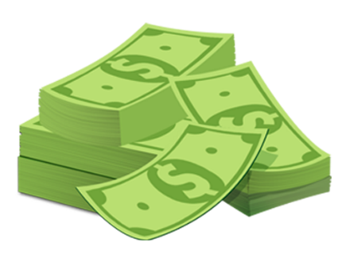
Risks of Cash
Theft Risk
Fire Hazard
Losing It (forgetting where you put it)
No Record of Spending
Notes:
The problem is that cash is vulnerable. It's not just about the risk of theft. It can be lost in a fire or a move, and once it's gone, it's gone forever. Plus, it gives you no record of your spending, making it hard to budget, and it certainly doesn't grow.

Slide 4
Why use a financial institution like a bank or credit union?
Notes:
This brings us to the solution: a financial institution, like a bank or credit union. These institutions were created to solve all the problems of the 'shoebox method.' They provide a secure and efficient way to manage your money.

Slide 5
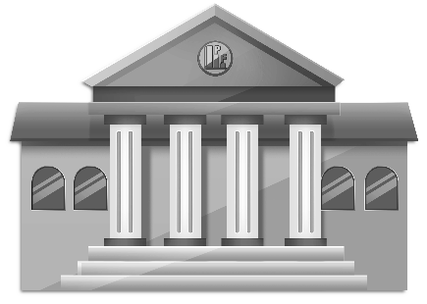
Benefits of Financial Institutions
Safety: FDIC/NCUA insurance protects your money up to $250,000 if the institution fails.
Convenience: Easily pay bills and make purchases without carrying cash.
Growth: The opportunity to earn interest and build wealth over time.
Notes:
So what are the benefits of using financial institutions?
Safety: Your money is insured by the federal government up to $250,000. If the institution fails, your money is protected.
Convenience: They make your financial life easy. You can pay bills, make purchases, and transfer money instantly without carrying around large amounts of cash.
Growth: They give your money the opportunity to earn interest and grow over time, which is something it can never do in a shoebox.

Slide 6


Choosing Your Financial Partner
Ownership: For-Profit Corporation (owned by shareholders)
Best For: Nationwide access, mobile technology, and a variety of financial products.
Downsides: Profit-driven model often leads to higher fees and lower interest rates for customers. Customer service can feel less personal.
Insured by the FDIC (Federal Deposit Insurance Corporation).
Ownership: Non-Profit Cooperative (owned by members, like you!)
Best For: Better rates and lower fees, community-focused, member-first approach
Downsides: Fewer physical locations and ATMs, may require membership edibility (e.g., living in a certain area).
Insured by the NCUA (National Credit Union Administration).
Notes:
Okay, so you're ready to open an account. Your first big decision is choosing your financial partner: a bank or a credit union?
They look similar, but their core philosophy is very different.
Banks are for-profit companies owned by shareholders.
Credit unions are non-profit cooperatives owned by their members—that's you.
This single difference is why credit unions often offer better interest rates and lower fees, while large banks often have more advanced technology and a wider network of ATMs.

Slide 7


Two Accounts Everyone Needs
Purpose: daily spending and bill payments
Accessibility: Very High (Debit Card, ATM, Checks)
Growth: Very Low or 0%
Like your wallet.
Purpose: short-term goals (emergency savings fund, car)
Accessibility: Medium (Transfers, Limited Withdrawals)
Growth: Low
Like your piggy bank.
Notes:
Once you've chosen your institution, you need to open the right accounts. Everyone should start with these two accounts:
A Checking Account:
It’s the central hub for all your financial activity.
Your paycheck gets deposited here, and your bills, rent, and daily purchases come out of it.
Its greatest strength is its very high accessibility. You can get to your money instantly with a debit card, at an ATM, by writing a check, or through an electronic transfer.
Money sitting in a checking account is losing purchasing power to inflation. Just like you wouldn't carry your life savings in your physical wallet, you shouldn't store large sums of money in your checking account.
A Savings Account:
This is your digital piggy bank.
Its entire purpose is to hold money you don't plan to touch in the short term.
This is where you build your emergency savings fund or save for specific goals like a vacation.
The primary job of a savings account isn't to make you rich; it's to be a safe, secure, and separate place for your goal-oriented money to accumulate.
By design, it's slightly harder to get money out of a savings account. You typically have to transfer it to your checking account first, and there used to be limits on how many withdrawals you could make per month. This little bit of friction is a feature, not a bug—it creates a psychological barrier that helps prevent you from making impulse purchases. It protects your savings from your daily spending habits.

Slide 8

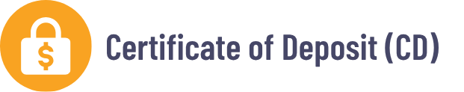
When You’re Ready to Earn More
Purpose: A hybrid account for larger savings balances.
Accessibility: Medium (Limited Check-Writing/Debit Card Use)
Growth: Variable rate, usually higher than a savings account
Like your savings account but with checking perks.
Purpose: Lock-in savings for a specific term or goal
Accessibility: Very Low (Fixed Term, Penalty for Early Withdrawal)
Growth: Higher than a savings account
Like a financial time capsule.
Notes:
What happens when you've built up a solid emergency fund or have a specific savings goal in mind and you want your money to work a little harder for you? That's when you graduate to these next-level accounts.
On the left, we have the Money Market Account, or MMA.
The best way to think of this is as a supercharged savings account. It typically offers a higher interest rate than a standard savings account, especially if you have a larger balance.
It gives you some limited 'checking perks,' like the ability to write a few checks a month or use a debit card.
This is a good place to keep a large emergency fund—you're earning more interest, but you can still access the money relatively easily if you need to.
On the right is the Certificate of Deposit, or CD.
With a CD, you are making a deal with the bank: you agree to lock your money away for a specific period of time, or 'term'—it could be six months, one year, five years, whatever you choose.
In exchange for that commitment, the bank guarantees you a higher interest rate for that entire period.
If you need to pull your money out before the term is up, you'll pay a penalty.
This makes CDs perfect for specific, time-bound goals, like saving for a down payment on a car you know you'll buy in two years.

Slide 9


Choosing the Right Home for Your Money
High Accessibility
Low Growth
Low Accessibility
High Growth
Least accessible
Variable growth
Moderate growth
Very accessible
Notes:
When choosing where to keep your money, you must balance two competing factors. The easier it is to access your money (high accessibility), the less it tends to grow.
A checking account is very accessible but has zero growth.
A Certificate of Deposit, or CD, has higher growth, but your money is locked away for a set period, making it the least accessible.

Slide 10
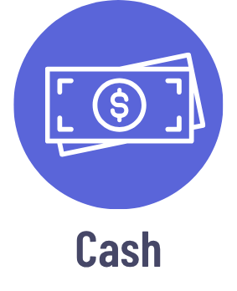
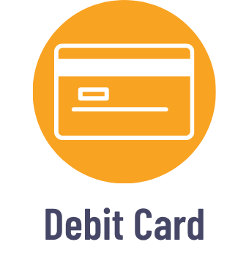
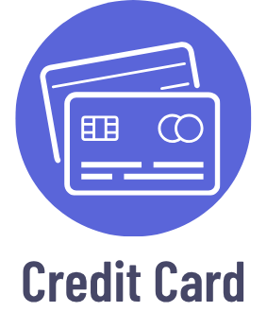
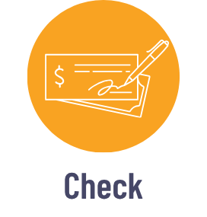
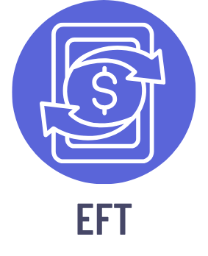
5 Ways to Make Payments
Notes:
Now that your money is in the right accounts, let's talk about the five main ways you'll use to spend it.
Cash is for small, in-person transactions.
A Debit Card is for everyday purchases, using money directly from your checking account.
A Credit Card is for online shopping and large purchases where you want fraud protection, and it's essential for building a credit history.
Checks are for formal payments like rent, where a paper trail is important.
And EFTs are for instantly paying friends or automating your online bill payments.

Slide 11

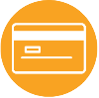
Ways to Pay
1. Cash
2. Debit Card
Best for: small in-person transactions, tipping, purchases at small vendors that don’t accept cards.
Key Features: universally accepted, untraceable (private), no fraud protection.
Best for: everyday purchases (groceries, gas), sticking to a budget, withdrawing cash from an ATM.
Key Features: deducted immediately from your checking account, convenient and widely accepted.
Notes:
Let's start with the oldest and most straightforward way to pay: cash. Its advantages are simple: it's accepted everywhere and offers complete privacy.
However, if you lose your wallet or your cash is stolen, there is no way to get it back. This is why it's a great tool for small, daily purchases, but not something you want to carry in large amounts.
A debit card is like digital cash. The money is gone from your account the second you swipe. It's great for budgeting because you can't spend money you don't have.
However, this also means your actual money is at risk if the card is compromised.

Slide 12

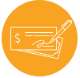
Ways to Pay
3. Credit Card
4. Check
Best for: online shopping, large purchases (for protection), building a positive credit history.
Key Features: excellent fraud protection, potential for rewards (cash back, points), creates debt if not paid in full each month.
Best for: large, formal payments (rent, down payments), paying contractors or services where a record is needed.
Key Features: provides a paper trail for both parties, can be cancelled if lost, slow processing time and not widely accepted.
Notes:
A credit card is a loan. The bank pays the merchant, and you owe the bank. There are several advantages:
First, it offers fraud protection, because it's the bank's money on the line, not yours.
Second, you can earn cash back, points or other rewards when you use your credit card.
Third, using it responsibly is one of the primary ways you build a positive credit history.
The main risk is the temptation to spend more than you can pay back, which leads to high-interest debt.
Next is a more traditional method: the paper check.
Checks are still the gold standard for large, important payments, like paying a down payment for a major asset like a car or house. Their main advantage is the paper trail they create, providing undeniable proof of payment for both you and the recipient. This is why landlords and contractors often prefer them.
The downside is that they are slow and have become less common for daily use.

Slide 13
Ways to Pay
5. Electronic Funds Transfer (EFT)
Best for: Instantly paying friends and family, automating recurring bill payments online
Examples: PayPal, Zelle, Venmo, online banking
Key Features:
Fast and convenient for digital transactions
Clear digital record of payment
Transactions are often irreversible (high risk if sent to the wrong person)
Notes:
Finally, we have Electronic Funds Transfer, or EFT, which are digital payments sent directly from your bank account via apps or online bill pay.
This is the technology behind apps like PayPal, Venmo and Zelle, and it's also how you pay your online bills. Its advantages are speed and convenience.
Peer-to-peer payment transactions are often instant and irreversible. So, if you send money to the wrong person or fall for a scam, it is very difficult, and often impossible, to get it back. Always double-check the username or phone number before you hit send.

Slide 14
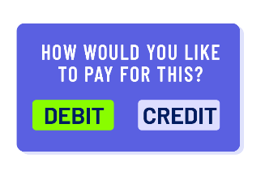
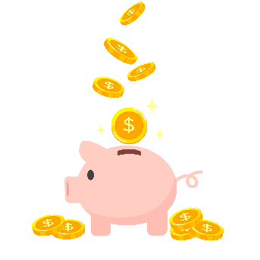
Key Takeaways
Research both local banks and credit unions to find the one that best fits your needs.
At a minimum, every saver needs a checking account for spending and a savings account for goals.
Understand the pros and cons of paying with different payment methods, like credit vs. debit.
Notes:
So, let's wrap it all up. What is the key to your Savings Toolkit?
First, choose the right partner. Research both local banks and credit unions to find the one that best fits your needs.
Second, open the right accounts. At a minimum, every saver needs a checking account for spending and a savings account for goals.
And finally, use the right payment method. Understand the pros and cons of paying with different payment methods, like credit vs. debit.

