Slide 1
Spending Plans
Personal Finance Lab

Slide 2
What is a Spending Plan?
Definition
A spending plan is a plan on how you will be spending your money each month.
What is Included
Your spending plan includes both your fixed and variable spendings.
Your fixed savings are usually the same each month, and include things like rent/motarge, insurance and groceries.
Your variable spending change from month to month, and include things like birthday gifts, doctor visits or buying new furniture.
Any extra funds can be allocated toward any other wants or put into some type of savings account or investment

Slide 3
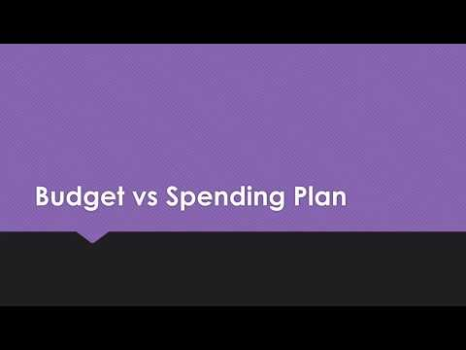
Spending Plan vs Budget
Similarities
Both are a list of how you will be spending your income on different expenses.
Differences
A budget as strict allowances or samounts that you cannot go over, since every dollar should be accounted for. For example, if you spend an extra $45 eating out that extra money must come from another part of your budget.
In a spending plan you plan for your expenses that are hard and essential first because those payments are most likely not going to change. Then any extra money that you have is considered discretionary income or money that you can use for whatever you want.

Slide 4
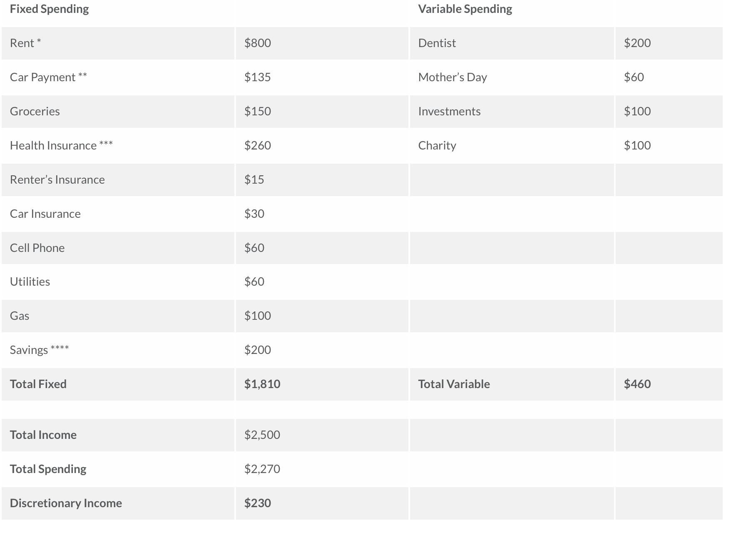
Example of a Spending Plan
Vocabulary
Fixed Spending
An expense that you cannot change easily month to month
Variable Spending
An expense that you might have one month but not every month
Total Income
How much money you deposit in the back every month.
Charity
You may not be able to donate every month but it is important to donate to charitable organizations
Savings and Investment
These numbers can change depending on your goals. The next slide will dive deeper into this.

Slide 5
Saving vs Investing
Saving
Saving is considered any type of stored value such as saving account, government bonds or even cash in a piggy bank.
Investing
Investing includes some type of risk with your money such as buying a stock or investing in a mutual fund.
Where They Fit in Your Spending Plan?
Your savings and investing might start off as a varidied spending but as you get better at spending less money, you should increase your saving or investing and move it into your fixed spendings. This will ensure that you are increasing your overall saving or investing.

Slide 6
Influences on Spending Plan
Marketing
Commercial, billboards and magazine advertisements all influence how you spend your money. This can be both a good or bad thing. You just have to make sure that you are aware of how marketing influences you.
Life Changes
Things like dating someone or having a child may have major effects on your spending plan because they add different expenses to your life. That is why it is important to look at your spending plan each month and adjust it for the different thing or events occuring in your life.
Importance of sticking to your Spending Plan
It is important to stick to your budget plan because that will allow you to have more extra spending money or money to put into savings or investing. Systems like an automatic payment will help you stay on track with paying your bills every month so that is is not something you have to worry about.

Slide 7
Assessment
01
05
Spending Plan Cycle
02
04
03
Implement and Control
Track Current Income and Expenses
Evaluate and Make Adjustments
Allocate Money to Each Category
Personalize Your Spending Plan

