Slide 1
The Alphabet Soup of Retirement
Your Guide to IRAs, 401(k)s, and More

Slide 2
Why Should You Care About Retirement NOW?
Notes:
Why should you care about retirement - NOW?

Slide 3

Why Should You Care About Retirement NOW?
Starting early gives you the greatest advantage in building your future.
Retirement isn't about getting old.
It's about having financial freedom and the choice to stop working when you want to.
The secret to achieve this is TIME, which you have more of right now than you ever will again.
Without proper planning, retirement may mean working longer than desired.
Notes:
Okay, I know what many of you are probably thinking when you see this slide: “That's decades away, and it's for old people.”
And you're right, it is a long way off. But the first and most important thing I want you to understand is that retirement is not about getting old. It's about having the financial freedom to stop working because you want to, not because you have to. It's about having the choice to travel, pursue a passion, or just relax, without ever needing another paycheck.
So, how do you achieve that freedom?
The secret isn't a huge salary or a lucky stock pick. The secret weapon is TIME.
And that is the one resource that you have more of right now than you will again. Every single dollar you invest today has 40 or 50 years to grow and compound on itself, a power that older investors can only dream of.
Starting early gives you the greatest possible advantage to build your future. On the other hand, you have someone who may have waited too long. He might be working not because he loves his job, but because he has no other choice.
The difference between those two futures is simply when you start.
The decisions you make in the next few years will have a bigger impact on your future wealth than any decisions you'll make in your 40s.
Your time is your superpower. Let's learn how to use it.

Slide 4





Where Will Your Money Come From?
Money You Grow Yourself
Money You May Be Promised
401(k)s
Annuities
Social Security
IRAs
Pensions
Notes:
When we talk about 'retirement income,' where will that money come from? Broadly speaking, it comes from two very different buckets.
On the right, we have the 'Money You May Be Promised.'
Think of this as your financial safety net. It includes things like Social Security, which is the government's retirement plan for everyone, and pensions, which are 'old-school' retirement plans where a company promised to pay you a check for life. Pensions are now very rare.
While these are a valuable foundation, they are largely outside of your control and can be affected by political changes, inflation, and other economic factors. Social Security, for example, was never designed to be a person's only source of income in retirement.
On the left, we have the 'Money You Grow Yourself.'
This is the bucket you fully control, and it is where financial freedom is grown. This category is made up of your personal retirement savings accounts, today we’ll be looking at the 401(k) and the IRA.
This is your money, in your account, invested the way you choose. We are going to focus first on the left side of this slide—the accounts that you control.

Slide 5

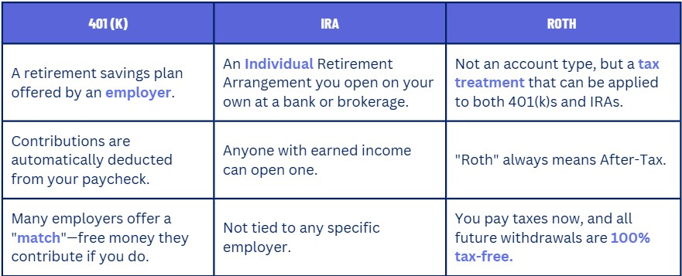
Retirement Accounts Defined
Notes:
Let’s make sure we get our vocabulary right. You'll hear these three terms all the time.
401(k). This is a retirement plan you get through your job. The best part is the potential for an employer match, which is one of the only forms of free money in the world.
IRA, which stands for Individual Retirement Arrangement. The key word is Individual. This is an account you open and manage yourself, separate from any employer.
Roth. This is where people get confused. Roth is not a separate type of account; it's a tax label. You can have a Roth 401(k) or a Roth IRA. When you see the word 'Roth,' you should immediately think 'After-Tax.’ You contribute money that's already been taxed, and in exchange, your withdrawals in retirement are tax-free.
So, we have two main account types (401k and IRA), and two main tax treatments (Traditional/Pre-Tax and Roth/After-Tax).

Slide 6

401(k): Offered By Your Employer
What it is: A retirement savings plan offered by your employer.
How it works:
Money is automatically taken from your paycheck before taxes are calculated, lowering your taxable income today.
Many companies will match your contributions up to a certain percentage.
Not taking the full match is like turning down a raise.
Why it matters:
Automatic savings from each paycheck.
Immediate tax deduction lowers taxable income.
Employer match is FREE MONEY.
Investments grow tax-deferred until retirement.
Notes:
Let's start with the 401(k).
So, what is it?
It's a retirement savings plan that you get through your job. It's one of the most valuable benefits a company can offer.
How does it work?
The beauty of the 401(k) is that it puts your savings on autopilot. The money is automatically taken from your paycheck and invested for you.
It's taken out before taxes are calculated. This is the 'pre-tax contribution' we talked about in our tax lesson, and it means your taxable income for the year is immediately lower.
Many companies will give you free money just for saving your own money in a 401(k). For example, they might match every dollar you contribute up to 5% of your salary. This is why the slide says not taking the full match is like turning down a raise—because it is. It's a key part of your compensation package.
So, why does this all matter?
The 401(k) makes saving automatic, which builds discipline.
It gives you an immediate tax break, which saves you money today.
And it allows your investments to grow tax-deferred, which helps them compound over time.
But the number one reason the 401(k) is so important is the employer match.
I want to be very clear about this: this is FREE MONEY. If your company offers a match, getting that full match should be your absolute #1 financial priority. It's the only investment in the world where you can get an instant 100% return. You cannot beat it.

Slide 7

IRA: Your Personal Retirement Account
What it is: An Individual Retirement Account that you open yourself at a bank or brokerage.
How it works:
Anyone with earned income – you don’t need an employer to have one.
You contribute money directly from your bank account on a schedule you set.
You must choose Traditional (pre-tax) or Roth (after-tax).
The IRS sets annual limits on contributions. (Check the IRS website for current limits).
Why it matters:
You choose from thousands of investments, not just a limited menu offered by an employer.
You can contribute on your own schedule and choose where to open your account.
Allows you to align your tax strategy with your career stage.
Notes:
The great news is that anyone with earned income can open an IRA—whether you're a freelancer, work a summer job, or your employer simply doesn't offer a 401(k).
Instead of automatic payroll deductions, you contribute money directly from your bank account whenever you want.
You must choose your tax strategy upfront:
Will it be a Traditional IRA, where you get a tax break now?
Or a Roth IRA, where you get tax-free withdrawals later?
The IRS does set annual limits on how much you can save. The best way to find the current number is to search online for 'IRS IRA contribution limits' for the current year.
For up-to-date contribution limits, go to: https://www.irs.gov/retirement-plans/plan-participant-employee/retirement-topics-ira-contribution-limits
Why does the IRA matter?
While the 401(k) is great, the IRA offers some advantages too.
The biggest one is Total Control. Instead of the 10 or 20 mutual funds your employer picks, you can choose from thousands of different investments.
It also offers incredible Flexibility and Accessibility. You're not tied to an employer, so if you're self-employed or your job doesn't have a retirement plan, the IRA is your primary tool for building wealth.
And finally, it gives you a Tax Advantage. You can choose between a Traditional and a Roth IRA.

Slide 8
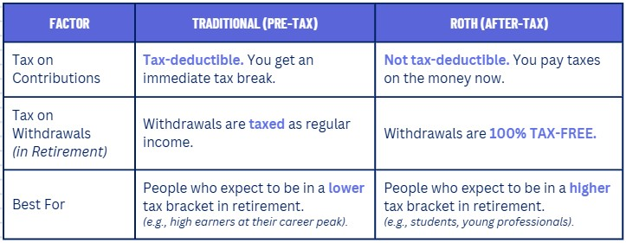
Traditional vs. Roth: Which Is Right for You?
Do you want a tax break now, or a tax break later?
Notes:
It's all about deciding if you want your tax break now or later. Let's look at the table.
With a Traditional account, your contributions are 'pre-tax,' which means they're tax-deductible today. This lowers your tax bill right now, which is a nice benefit.
With a Roth account, you contribute 'after-tax' money. There's no immediate tax break.
The trade-off comes in retirement. When you withdraw from a Traditional account, you'll pay income tax on every dollar. But with a Roth, every single dollar you take out—including decades of investment growth—is 100% tax-free.
So, which one is right for you? It comes down to: will your tax rate be higher today or in the future?
If you're a student or just starting your career, your income is likely the lowest it will ever be. Your tax rate is low. So, the Roth option is likely the best choice for you. Pay the low taxes now while your income is low and enjoy tax-free growth and withdrawals forever.

Slide 9
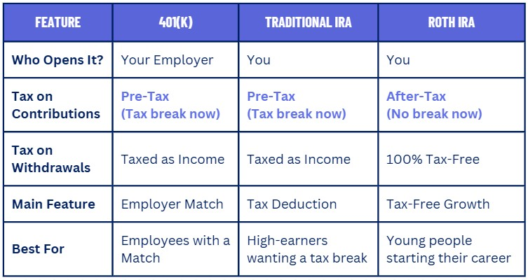
Putting it All Together
Notes:
Okay, we've looked at each of these accounts individually. This table puts everything we've discussed side-by-side, so you can see the key differences at a glance. Let's walk through it.
First, Who Opens It?
The 401(k) is tied to your employer.
The IRAs—both Traditional and Roth—are accounts you open and control yourself.
Next, the Tax Treatment.
Notice that both the 401(k) and the Traditional IRA are Pre-Tax. You get your tax break now, but in exchange, your withdrawals in retirement will be taxed as regular income.
The Roth IRA is the opposite. It's After-Tax, meaning no tax break today, but the massive payoff is that all your withdrawals in retirement are 100% tax-free.
This leads us to the Main Feature of each account.
For the 401(k), it's the Employer Match. That is free money you can't get anywhere else.
For the Traditional IRA, it's the personal Tax Deduction, which is a great tool for people who have a high income right now.
And for the Roth IRA, the main feature is that Tax-Free Growth leading to those tax-free withdrawals.
Finally, this brings us to who is this Best For...
The 401(k) is a no-brainer for any employee with a company match.
The Traditional IRA is generally best for high-earners who need a tax break today.
And the Roth IRA is the perfect tool for young people just starting their careers.

Slide 10
Retirement Foundation
These three sources form the foundation of retirement income, but your personal savings are what will give you financial freedom.
Notes:
So far, we’ve focused entirely on the retirement accounts that you personally own and control—your 401(k) and your IRA. Now, let's briefly shift gears and talk about the other side of the equation.
Remember earlier when we discussed the two buckets of retirement income? This is the 'Money You May Be Promised' bucket. We call these three sources the Retirement Foundation.
The common thread with all three of these is that you do not control the money yourself. A government agency, a former employer, or an insurance company manages the funds and sends you a check based on a formula. You are promised a payment. The key word here is 'promised.' You don't have direct control over this money. The government or a former employer manages it, and they send you a check in the mail.

Slide 11
Retirement Foundation
Annuities
Social Security
Personal pension from an insurance company
Give a lump sum, get guaranteed check
Can provide income for set period or for life
Adds predictability to retirement income
Government provided retirement plan
Funded by FICA taxes throughout working life
Provides monthly check in retirement
Foundation but not enough to live on comfortably
Notes:
Let's take a closer look at the two most common parts of the retirement foundation.
On the left, we have Annuities.
You can think of an annuity as a personal pension that you buy for yourself from an insurance company.
You give the insurance company a large lump sum of your savings, and in exchange, they guarantee you a fixed monthly check, either for a set number of years or for the rest of your life.
The main benefit of an annuity is that it adds predictability to your retirement income. You know exactly how much money is coming in each month, which can help cover your basic living expenses.
The trade-off is that you give up control of that lump sum of money, and the returns are often lower than what you could achieve by investing the money yourself.
It's a choice to trade potential growth for guaranteed income.
On the right, we have Social Security.
This is the government's retirement plan, which almost every working American pays into through the FICA taxes we discussed in our tax lesson.
In return for those taxes, you are promised a monthly check from the government after you reach retirement age. The amount you get depends on how much you earned during your working life.
Social Security is a foundation, but it is not enough to live on comfortably. It was designed as a safety net to prevent poverty among the elderly, not to fund a comfortable retirement.
It will be a helpful supplement, but you cannot rely on it as your only source of income.

Slide 12
Retirement Foundation
Pensions
Old-school retirement plan
Company promises fixed monthly check for life
Very rare in private sector today
Your grandparents might have one
#1 Rule: Don't Touch Your Retirement Accounts!
Notes:
Let's briefly cover the final piece of the traditional 'Retirement Foundation': the pension.
As the slide says, you can think of this as an 'old-school' retirement plan.
Here's how it worked: in your grandparents' generation, it was common for someone to work for the same company for 30 or 40 years. As a reward for that loyalty, the company would promise to pay them a fixed monthly check for the rest of their life after they retired. The key word here is 'promise.’
The company was responsible for all the saving and investing; the employee just had to stay with the company long enough to qualify.
This model is very rare in the private sector today because it became too expensive for companies to maintain. Most have replaced pensions with 401(k) plans, which shifts the responsibility of saving from the company to the employee. While pensions are still common in public sector jobs like teaching or government work, it's not something most people should expect to receive.
Now, that covers the 'promised' money. Before we get to our final action plan for the money you control, there's one critical rule we need to establish for your personal retirement accounts... and that is Rule #1: Don't Touch Them!

Slide 13
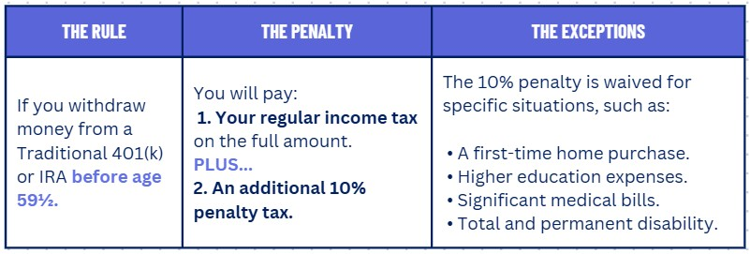
The Early Withdrawal Penalty
Retirement accounts are for retirement. Withdrawing early has serious consequences.
The Bottom Line: This money is for your future self. It is not an emergency fund. Leave it alone and let it compound!
Notes:
The government provides huge tax breaks for these retirement accounts because they want to incentivize long-term saving. To enforce this, they've created a significant penalty for taking money out too early.
The general rule is this: if you withdraw money from a Traditional 401(k) or IRA before you turn 59 and a half, you'll face a double hit.
First, you'll have to pay your regular income tax on the entire amount you withdraw.
On top of that, you'll be charged an additional 10% penalty tax. This can easily wipe out a huge portion of your savings. The message from the government is clear: Don't touch this money.
However, the IRS understands that major life events happen. They have created a list of exceptions that allow you to withdraw money early without paying that 10% penalty. You still have to pay the income tax, but you avoid the extra penalty. Some of the most common exceptions include:
Using up to $10,000 for a first-time home purchase.
Paying for qualified higher education expenses for you or your family.
Covering major unreimbursed medical bills.
And in cases of total and permanent disability.
But remember the main point: this money is for your future self. It is not a backup savings account or an emergency fund. Your best strategy is to leave it alone and let the power of compound interest work its magic for decades to come.
Reference: https://www.irs.gov/retirement-plans/hardships-early-withdrawals-and-loans

Slide 14
Your Action Plan
Step 1. Maximize Your 401(k) Match: If your job offers one, contribute at least enough to get the full employer match.
Step 2. Open a Roth IRA: Set up automatic monthly contributions, even if it's just $25 or $50 to start.
Step 3. Choose Simple Investments: Select diversified investments inside your accounts, like a target-date fund.
Step 4. Let Time Work Its Magic: Let time and compound interest do the heavy lifting for the next 40 years!
Notes:
This slide gives you a simple, four-step plan to start building your retirement wealth today.
Step 1: Maximize Your 401(k) Match.
This is your absolute #1 priority. If your job offers a match, it is free money. Do not leave it on the table. Contribute at least enough to get the full amount your employer is offering you.
Step 2: Open a Roth IRA.
After you've secured your match, your next move is to open your own personal retirement account. The most important part here is just to start. Even if it's only $25 or $50 a month, you are building the habit of paying yourself first.
Step 3: Choose Simple Investments.
Don't let the idea of investing overwhelm you. You don't need to be a stock-picking genius. A simple, diversified option like a target-date fund is a perfect way to start. It's designed to automatically do the hard work for you.
Step 4: Let Time Work Its Magic.
Once you have this system set up—contributing automatically to simple investments—your main job is to be patient. Let your money and the incredible power of compound interest do the heavy lifting for the next 40 years.

Slide 15

Key Takeaways
You know the difference between employer plans (401k) and personal plans (IRAs).
You know when to choose to Pay Tax Now (Roth) vs. Pay Tax Later (Traditional).
You have a clear plan to start building your retirement wealth.
Notes:
Let's recap what we’ve learned:
First, you now know the difference between an employer plan like a 401(k) and a personal plan like an IRA, and you know the unique strengths of each.
Second, you understand why you might choose to 'Pay Tax Now vs. Pay Tax Later,' and you know why a Roth IRA is so valuable for someone just starting their career.
And finally, putting it all together, you have a clear, actionable plan to start building your retirement wealth right now.
Remember: retirement isn't about getting old; it's about building a life of financial freedom. You now have the knowledge and the plan to make that happen!

