Slide 1
Understanding Payroll Deductions
Where Does Your Money Go?

Slide 2
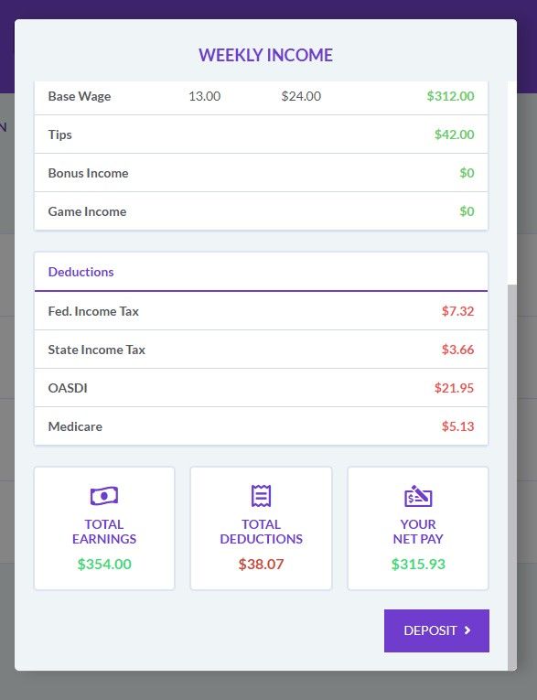
What Are Payroll Deductions?
Amounts withheld from your gross pay before you receive your take-home pay.
Fund essential government services that benefit everyone.
The difference between gross pay (total earnings) and net pay (take-home pay).
Notes:
Let's start by looking at this sample pay stub. The Gross Pay, or Total Earnings, is $354. This is the 'sticker price' of your work—the full amount you earned before anything was taken out. But the amount that gets added to your bank account, the Net Pay, is $315.93. The difference between these two numbers is your Total Deductions—in this case, about $38.
Our goal today is to understand exactly what those deductions are, where that money goes, and why it's taken out. Think of it as paying for your share of the country and community you live in before you get your personal share.

Slide 3

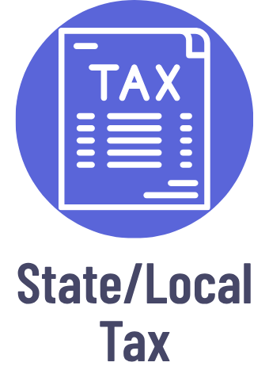


Main Payroll Deductions
Notes:
These four items are the most common deductions you'll see on every paycheck. We can group them into two main categories:
Income Taxes (Federal and State/Local): This money goes into a big pot called a 'general fund' to pay for public services.
FICA Taxes (Social Security and Medicare): This money is more like paying an insurance premium. It goes into specific trust funds dedicated only to funding Social Security and Medicare benefits.
While almost everyone pays Federal and FICA taxes, State/Local tax depends entirely on where you live. Some states, like Texas or Florida, have no state income tax at all.

Slide 4


Federal Income tax
Mandatory deduction from your paycheck based on earnings.
Amount depends on your income level and filing status.
Funds essential national services, like:
Notes:
The amount of federal income tax taken from your check is an estimate. When you start a job, you fill out a W-4 form. This form tells your employer about your life (if you're single, married, have kids, etc.) so they can estimate how much tax you'll owe at the end of the year.
They withhold a piece of that estimate from each paycheck. This is why some people get a tax refund—their employer withheld more than they owed. If they withheld too little, you must pay the difference.
Think of it like a 'pay-as-you-go' system for funding the entire country.

Slide 5


State/Local Income tax
Local taxation varies by state and municipality.
Rates and rules differ by location – some states have no income tax.
Funds community services that directly impact your daily life, like:
Notes:
The primary sources of funding for state and local services includes are roughly:
Property Tax (on homes and land): 30%
Sales Tax (on goods and services): 25%
Individual Income Tax (on people's wages): 25%
Corporate Income Tax: 5%
Other Taxes (gasoline taxes, vehicle registration fees, rental cars, hotel stays, and “sin taxes” like tobacco and alcohol”): 20%
Note: Because of the rounding, these numbers add up to 105%.

Slide 6


FICA Taxes Overview
FICA stands for Federal Insurance Contribution Act.
Mandatory payroll tax that funds Social Security and Medicare Programs.
Both employees and employers contribute equally.
6.2%
1.45%
Total Employee Contribution: 7.65%
Notes:
The most important concept on this slide is the employer match. You pay 7.65%, and your employer pays a matching 7.65% on your behalf. So, in total, 15.3% of your earnings are sent to fund these programs. This is a hidden part of your compensation package. Your employer is contributing to your future retirement and health benefits, but you never see that money on your pay stub.
This is different from income tax. FICA is a flat tax rate. Everyone pays the same percentage, regardless of their income (with one key exception we'll see next).

Slide 7


Social Security
6.2% tax rate on employee earnings, matched by employer.
Provides financial security for workers and their families.
Notes:
It’s important to know that Social Security is more than just a retirement program. It's a social insurance program. It also provides:
Disability Insurance: If you have a medical condition that keeps you from working.
Survivor Benefits: If a working parent passes away, it provides income to support their minor children.
The Social Security tax has an annual income limit. Unlike Medicare, you only pay the 6.2% Social Security tax on your earnings up to a certain amount each year. Any money you earn above that limit for the rest of the year is not taxed for Social Security. This limit changes almost every year to keep up with inflation. To find the current, up-to-date limit, you can always check the official Social Security Administration website at this link: https://www.ssa.gov/faqs/en/questions/KA-02387.html.

Slide 8


Medicare
1.45% tax rate on all employee earnings, matched by employer.
Provides health insurance for eligible individuals.
Unlike Social Security, Medicare tax has no income limit.
Notes:
The key difference between Medicare and Social Security is there is no income limit for Medicare tax.
You pay the 1.45% on every single dollar you earn. This is to ensure the healthcare system is funded by everyone, especially high earners. In fact, for those earning over $200,000, there is an 'Additional Medicare Tax' where the rate increases slightly.
The funds from this tax go directly to the Medicare Trust Fund, which pays the hospital bills for retirees and eligible disabled individuals.

Slide 9
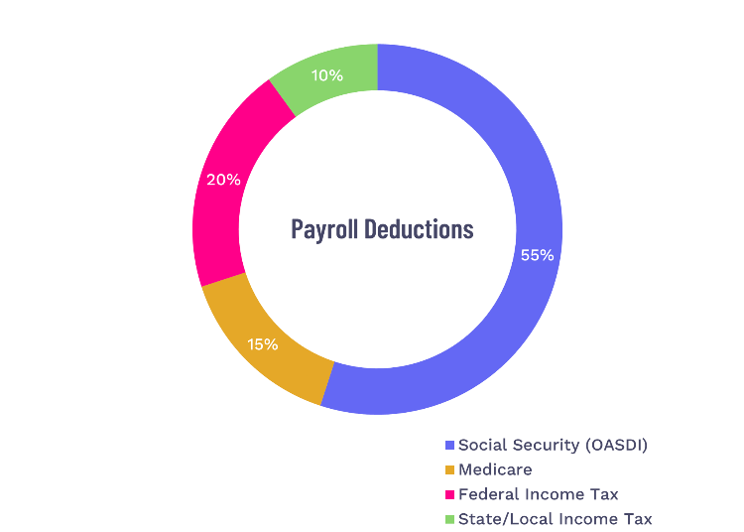
Key Takeaways
Federal Income Tax: funds national services like National Parks and Military.
State/Local Tax: funds local services like Schools and Police Officers.
FICA Taxes: funds Social Security and Medicare.
Notes:
So, let's bring it all back to that sample pay stub we saw at the beginning. This pie chart shows where that $38 in deductions went.
Breakdown:
Social Security (OASDI): $21.95
Medicare: $5.13
Federal Income Tax: $7.32
State Income Tax: $3.66
The biggest slice, at 55%, is Social Security. This is the money that funds retirement, disability, and survivor benefits.
The next biggest, at 20%, is Federal Income Tax. This goes into the nation's general fund for everything from National Parks to the military.
After that, at 15%, we have Medicare, our national health insurance program for retirees and the disabled.
And the smallest slice in this example, at 10%, is State Tax, which stays in our community to pay for things like schools and police officers.
So, while Gross Pay and Net Pay can seem very different, the money in between isn't gone—it's being put to work.

